Slide 1

Held in conjunction with
ASPEN’s Clinical
Nutrition Week 2017
Moderator
Charles Mueller, PhD, RDN, CDN, CNSC
New York, New York
Faculty
Daren Heyland, MD
Kingston, Ontario, Canada
Claude Pichard, MD, PhD
Geneva, Switzerland

Slide 2
Nutrition Risk Assessment in
Critically Ill Patients!
Daren Heyland, MD, MSc.
Professor of Medicine
Queen’s University, Kingston General Hospital
Kingston, ON Canada

Slide 3
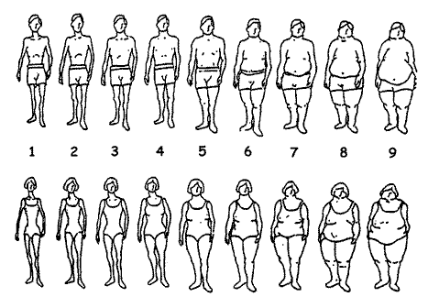
ICU patients are not all created equal…should we expect the impact of nutrition therapy to be the same across all patients?

Slide 4
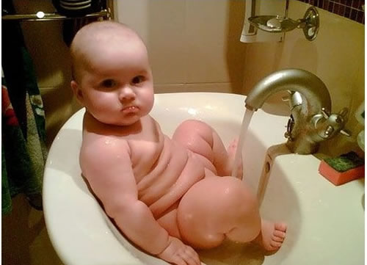
How do we figure out who will benefit the most from nutrition therapy?
Notes:
Need picture of malnourshed child

Slide 5
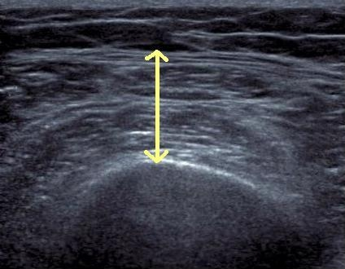
Who might benefit the most from nutrition therapy?
Clinical
  BMI
  Projected long length of stay
  Nutritional history variables
High NUTRIC Score
Low NUTRIC with risk factors
Sarcopenia
  CT vs. bedside US
  Frailty measures
Others?

Slide 6
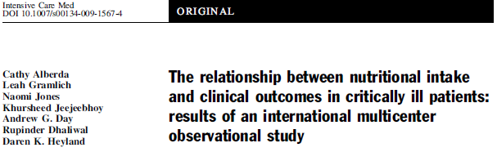
Point prevalence survey of nutrition practices in ICU’s around the world conducted Jan. 27, 2007
Enrolled 2772 patients from 158 ICU’s over 5 continents
Included ventilated adult patients who remained in ICU >72 hours
Alberda C et al. Intensive Care Med. 2009;35(10):1728-37.

Slide 7
Relationship of Protein/Caloric Intake, 60 day Mortality and BMI

Slide 8

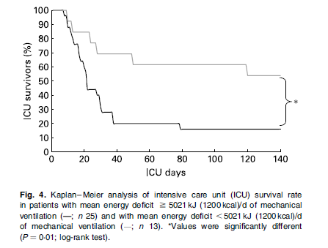
Mechanically Vent’d Patients >7 days (average ICU LOS 28 days)
Faisy C et al. Br J Nutr. 2009;101(7):1079-1087.

Slide 9
How do we figure out who will benefit the most from nutrition therapy?
Notes:
Need picture of malnourshed child

Slide 10
Nutrition Risk Screening 2002
Impaired nutritional status |  | Severity of disease (≈stress metabolism)
Absent Score 0 | Normal nutritional status | Absent Score 0 | Normal nutritional requirements
Mild Score 1 | Wt loss >5% in 3 months Or Food intake below 50-75% of normal requirement in preceding week | Mild Score 1 | Hip fracture Chronic patients, in particular with acute complications: cirrhosis (11), COPD (12) Chronic hemodialysis, diabetes, oncology
Moderate Score 2 | Wt loss >5% in 2 months Or BMI 18.5 - 20.5 + impaired general condition Or Food intake 25-50% of normal requirement in preceding week | Moderate Score 2 | Major abdominal surgery (13-15). Stroke (16) Severe pneumonia, hematologic malignancy
Severe Score 3 | Wt loss >5% in 1 month (≈ >15% in 3 months (17)) Or BMI <18.5 + impaired general condition (17) Or Food intake 0-25% of normal requirement in preceding week | Severe Score 3 | Head injury (18, 19) Bone marrow transplantation (20) Intensive care patients (APACHE 10)
Calculate the total score: Find score (0-3) for Impaired nutritional status (only one: choose the variable with highest score) and Severity of disease (≈stress metabolism, i.e.. increase in nutritional requirements). Add the two scores (→ total score) If age >70 years: add 1 to the total score to correct for frailty of elderly If age-correlated total >3: start nutritional support
All ICU patients treated the same
Adapted from: Kondrup J et al. Clin Nutr. 2003;22(3):321-36.

Slide 11
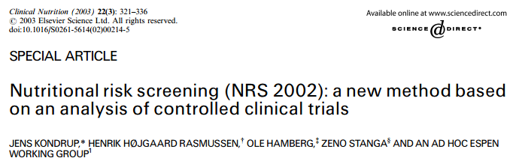
50
Pos
40
No
NRCT
30
20
10
2
≥2-<2.5
≥2.5-<3
≥3-<3.5
≥3.5-<4
≥4
Total Score
Adapted from: Kondrup J et al. Clin Nutr. 2003;22(3):321-36.

Slide 12
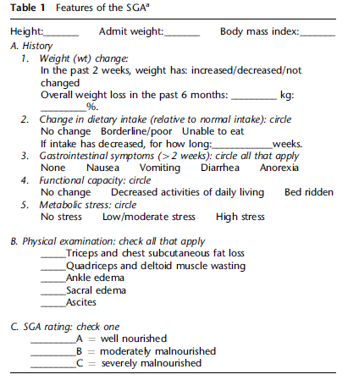
Subjective global assessment?

Slide 13
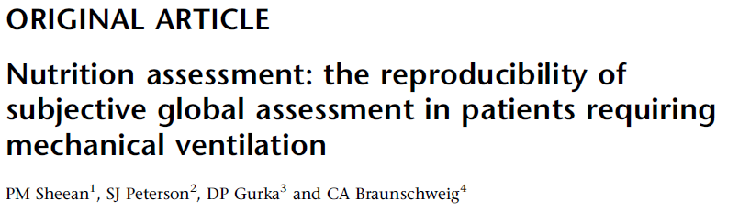
Frequency of subjective global assessment characteristics on admission to the medical intensive care unit in patient requiring mechanical ventilation
Variable | All patients n=57 | Normally Nourished n=28 | Moderate or severely malnourished n=29
In the past 2 weeks weight has: No change – n (%) Decreased – n (%) Increased – n (%) Unable to obtain/assess changes – n (%) Weigh loss in the last 6 months No – n (%) Yes – n (%) Unable to obtain/assess changes – n (%) Change in dietary intake No change – n (%) Borderline/poor – n (%) Unable to eat – n (%) Unable to obtain/assess changes – n (%) | 28 (49) 17 (30) 4 (7) 8 (8) 22 (39%) 18 (30%) 17 (31%) 17 (30) 33 (58) 2 (3) 5 (9) | 7 (61) 5 (18) 1 (4) 5 (18) 18 (64%) 3 (11%) 7 (25%) 12 (43) 13 (46) 0 (0) 3 (11) | 11 (38) 12 (41) 3 (10) 3 (10) 4 (14%) 15 (52%) 10 (34%) 5 (17) 20 (69) 2 (7) 2 (7)
When training provided in advance, can produce reliable estimates of malnutrition
Note rates of missing data
Adapted from: PM Sheenan et al. Eur J Clin Nutr. 2010;64(11):1358-1364.

Slide 14
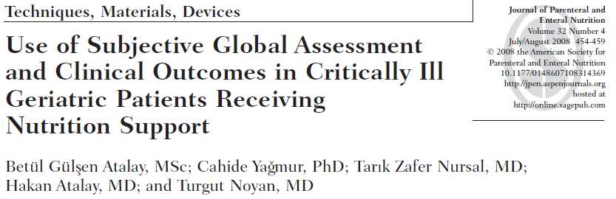
Mostly medical patients; not all ICU
Rate of missing data?
No difference between well-nourished and malnourished patients with regard to the serum protein values on admission, LOS, and mortality rate.
66.4%
Well nourished
27.7%
Moderately malnourished
5.9%
Severely malnourished
0 10 20 30 40 50 60 70 80 90 100
Assessment of malnutrition according to the subjective global assessment. Prevalence of malnutrition was present in 40(33.6%) of the 119 included patients.
Adapted from: Atalay BG et al. JPEN J Pareneter Enteral Nutr. 2008;32(4):454-9.

Slide 15
How do we figure out who will benefit the most from nutrition therapy?
Notes:
Need picture of malnourshed child

Slide 16
A Conceptual Model for Nutrition Risk Assessment in the Critically Ill
Acute
Reduced po intake
pre ICU hospital stay
Chronic
Recent weight loss
BMI?
Starvation
Nutrition Status
micronutrient levels - immune markers - muscle mass
Inflammation
Acute
IL-6
CRP
PCT
Chronic
Comorbid illness

Slide 17
The Development of the NUTrition Risk in the Critically Ill Score (NUTRIC Score)
When adjusting for age, APACHE II, and SOFA, what effect of nutritional risk factors on clinical outcomes?
Multi institutional data base of 598 patients
Historical po intake and weight loss only available in 171 patients
Outcome: 28 day vent-free days and mortality
Heyland DK et al. Crit Care. 2011;15:R268.

Slide 18
What are the nutritional risk factors associated with clinical outcomes? (validation of our candidate variables)
 | Non-survivors by day 28 (n=138) | Survivors by day 28 (n=460) | P values
Age | 71.7 [60.8 to 77.2] | 61.7 [49.7 to 71.5] | <.001
Baseline APACHE II score | 26.0 [21.0 to 31.0] | 20.0 [15.0 to 25.0] | <.001
Baseline SOFA | 9.0 [6.0 to 11.0] | 6.0 [4.0 to 8.5] | <.001
# of days in hospital prior to ICU admission | 0.9 [0.1 to 4.5] | 0.3 [0.0 to 2.2] | <.001
Baseline Body Mass Index | 26.0 [22.6 to 29.9] | 26.8 [23.4 to 31.5] | 0.13
Body Mass Index |  |  | 0.66
<20 | 6 (4.3%) | 25 (5.4%)
≥20 | 122 (88.4%) | 414 (90.0%)
# of co-morbidities at baseline | 3.0 [2.0 to 4.0] | 3.0 [1.0 to 4.0] | <0.001
Co-morbidity |  |  | <0.001
Patients with 0-1 co-morbidity | 20 (14.5%) | 140 (30.5%)
Patients with 2 or more co-morbidities | 118 (85.5%) | 319 (69.5%)
C-reactive protein¶ | 135.0 [73.0 to 214.0] | 108.0 [59.0 to 192.0] | 0.07
Procalcitionin¶ | 4.1 [1.2 to 21.3] | 1.0 [0.3 to 5.1] | <.001
Interleukin-6¶ | 158.4 [39.2 to 1034.4] | 72.0 [30.2 to 189.9] | <.001
171 patients had data of recent oral intake and weight loss
 | Non-survivors by day 28 (n=32) | Survivors by day 28 (n=139) | P values
% Oral intake (food) in the week prior to enrolment | 4.0 [1.0 to 70.0] | 50.0 [1.0 to 100.0] | 0.10
% of weight loss in the last 3 month | 0.0 [0.0 to 2.5] | 0.0 [0.0 to 0.0] | 0.06

Slide 19
The Development of the NUTrition Risk in the Critically Ill Score (NUTRIC Score)
Variable | Range | Points
Age | <50 | 0
 | 50-<75 | 1
 | >=75 | 2
APACHE II | <15 | 0
 | 15-<20 | 1
 | 20-28 | 2
 | >=28 | 3
SOFA | <6 | 0
 | 6-<10 | 1
 | >=10 | 2
# Comorbidities | 0-1 | 0
 | 2+ | 1
Days from hospital to ICU admit | 0-<1 | 0
 | 1+ | 1
IL6 | 0-<400 | 0
 | 400+ | 1
AUC | 0.783
Gen R-Squared | 0.169
Gen Max-rescaled R-Squared | 0.256
BMI, CRP, PCT, weight loss, and oral intake were excluded because they were not significantly associated with mortality or their inclusion did not improve the fit of the final model.

Slide 20
The Validation of the NUTrition Risk in the Critically Ill Score (NUTRIC Score)

Slide 21
The Validation of the NUTrition Risk in the Critically Ill Score (NUTRIC Score)

Slide 22
The Validation of the NUTrition Risk in the Critically Ill Score (NUTRIC Score)
Interaction between NUTRIC Score and nutritional adequacy (n=211)*
P value for the interaction=0.01
Heyland DK et al. Crit Care. 2011;15:R268.

Slide 23
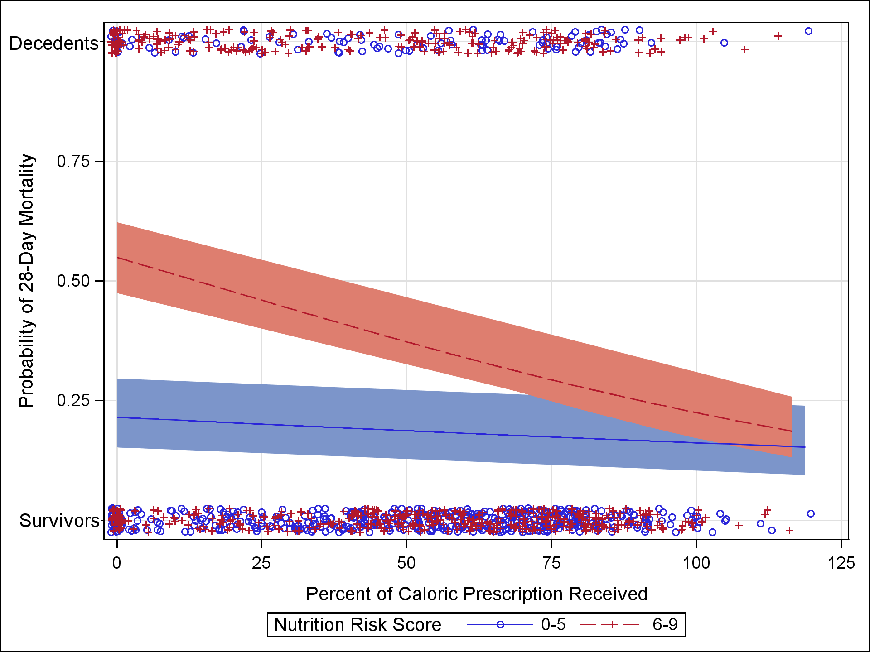
Further Validation of the “Modified NUTRIC” Nutritional Risk Assessment Tool
In a second data set of 1200 ICU patients
Minus IL-6 levels
Rahman A et al. Clin Nutr. 2016;35(1):158-62.

Slide 24
NUTRIC Score Performs the Same Whether Patient had EFI or Not
Rahman A et al. Clin Nutr. 2016;35(1):158-62.

Slide 25
Validation of NUTRIC Score in Large International Database >2800 patients from >200 ICUs
Protein
Calories
^Faster time-to-discharge alive with more protein and calories ONLY in the high NUTRIC group
Compher C et al. Crit Care Med. 2017;45(2):156-163.

Slide 26
The Validation of the NUTrition Risk in the Critically Ill Score (NUTRIC Score)
Validated in 3 separate databases including the INS Dataset involving over 200 ICUs worldwide^{1,2,3}
Validated without IL-6 levels (modified NUTRIC)²
Independently validated in Brazilian, Portuguese, and Asian populations^{4,5,6}
Not validated in post hoc analysis of the PERMIT trial⁷
  RCT of different caloric intake (protein more important)
  Underpowered, very wide confidence intervals
4. Rosa Clinical Nutrition ESPEN 2016
5. Mendes J Crit Care. 2017
6. Mukhopadhyay Clinical Nutrition. 2016
7. Arabi Am J RCCM. 2016
Heyland DK et al. Crit Care. 2011;15:R268.
Rahman, Clinical Nutrition 2015
3. Compher C et al. Crit Care Med. 2017;45(2):156-163.

Slide 27
Results of TOP UP Pilot Trial
A RCT of supplemental PN in low and high BMI ICU patients
Post-hoc subgroup analysis
In submission

Slide 29
Are all low NUTRIC score patients the same?
The Impact of Optimal Nutrition Intake in Low NUTRIC Patient Subgroups
Analysis of 2013/2014 INS Data
4334 had a NUTRIC SCORE ≤5 of which 4060 had least 3 evaluable days
The overall 60-day hospital mortality in this sample was 714/4060 (18%).
The median [Q1 to Q3] ICU length of stay was 11.0 [6.4 to 20.9] days.
The mean±SD total percent prescription received by EN, PN, propofol or protein supplements during the first 12 evaluable days was 56.7±28.0 for energy and 53.0±29.1 for protein
Per 20% increase in proportion of prescription received the adjusted odds ratio for 60 day hospital mortality was OR=1.04 (95% CI, 0.96 to 1.13) for energy and OR=1.03 (95% CI, 0.96 to 1.11) for protein

Slide 30
Are all low NUTRIC score patients the same?
The Impact of Optimal Nutrition Intake in Low NUTRIC Patient Subgroups
Is there a treatment effect in various subgroups of low NUTRIC?
  10% had low BMI,
  46% in ICU >12 days
  56% had one or more marker of malnutrition (reduced po intake, hx of weight loss)
In the various subgroup analyses, no significant associations were identified
Numbers were small and unable to really test of interactions
? Other nutritionally high-risk subgroups in the low NUTRIC group?

Slide 31
Association Between Nutrition Intake and SF-36 by Baseline NUTRIC Score in Patients Ventilated in ICU for > 8 Days
Predictor | Overall |  | NUTRIC 0-5 |  | NUTRIC 6-9 |  | Interaction
Energy | Estimate (95% CI) | P-value | Estimate (95% CI) | P-value | Estimate (95% CI) | P-value | P-value
Physical Functioning 3 mo 7.5 (2.1 to 12.9) 6 mo 5.3 (0.2 to 10.5) |  | 0.007 0.04 | 3.5 (-1.9 to 8.9) 1.1 (-4.2 to 6.3) | 0.2 0.69 | -0.6 (-6.9 to 5.6) -0.3 (-6.3 to 5.8) | 0.839 0.935 | 0.31 0.74
Role Physical 3 mo 8.2 (3.0 to 13.4) 6 mo 5.1 (-0.0 to 10.2) |  | 0.002 0.05 | 5.1 (-0.2 to 10.5) 1.5 (-3.8 to 6.8) | 0.06 0.58 | 2.2 (-4.1 to 8.5) -0.1 (-6.2 to 5.9) | 0.499 0.962 | 0.46 0.68
Physical Component Scale 3 mo 1.8 (-0.1 to 3.6) 6 mo 1.8 (-0.1 to 3.7) |  | 0.06 0.05 | 1.7 (-0.2 to 3.7) 0.7 (-1.3 to 2.6) | 0.07 0.51 | 0.9 (-1.3 to 3.1) -0.5 (-2.8 to 1.7) | 0.402 0.634 | 0.57 0.41
Protein
Physical Functioning 3 mo 7.3 (1.7 to 12.9) 6 mo 5.2 (-0.1 to 10.6) |  | 0.01 0.05 | 3.8 (-2.0 to 9.7) 0.3 (-5.4 to 6.0) | 0.20 0.91 | -0.6 (-7.6 to 6.4) 1.2 (-5.5 to 7.9) | 0.867 0.731 | 0.32 0.84
Role Physical 3 mo 8.7 (3.3 to 14.1) 6 mo 4.3 (-0.9 to 9.6) |  | 0.002 0.10 | 6.5 (0.7 to 12.3) 1.0 (-4.7 to 6.8) | 0.03 0.73 | 4.1 (-2.9 to 11.0) 0.6 (-6.1 to 7.3) | 0.248 0.864 | 0.58 0.92
Physical Component Scale 3 mo 1.9 (-0.0 to 3.8) 6 mo 1.7 (-0.2 to 3.7) |  | 0.05 0.08 | 2.2 (0.2 to 4.3) 0.8 (-1.4 to 2.9) | 0.03 0.49 | 0.8 (-1.6 to 3.3) -0.3 (-2.7 to 2.2) | 0.498 0.827 | 0.38 0.52
Per 25% Increase in proportion of prescription received by EN or PN
No difference in low vs High NUTRIC
Increased protein intake = improve physical recovery

Slide 32
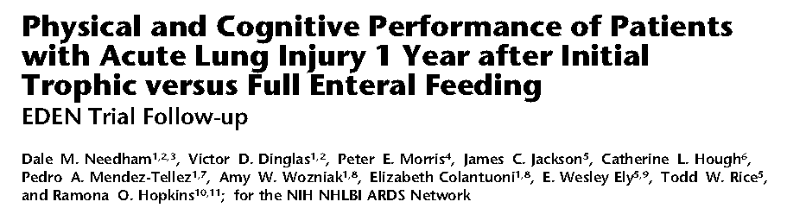
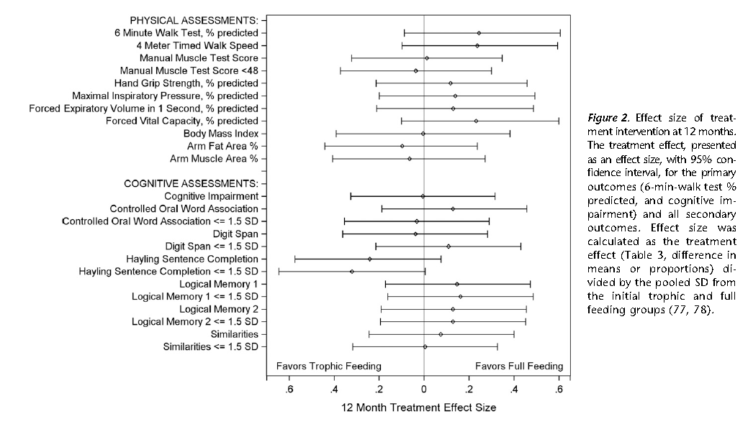

Slide 33
Do all ICU patients benefit the same from the point of view of their physical recovery?

Slide 34
Who might benefit the most from nutrition therapy?
Clinical
  BMI
  Projected long length of stay
  Nutritional history variables
High NUTRIC Score
Low NUTRIC with risk factors
Sarcopenia
  CT vs. bedside US
  Frailty measures
Others?

Slide 35
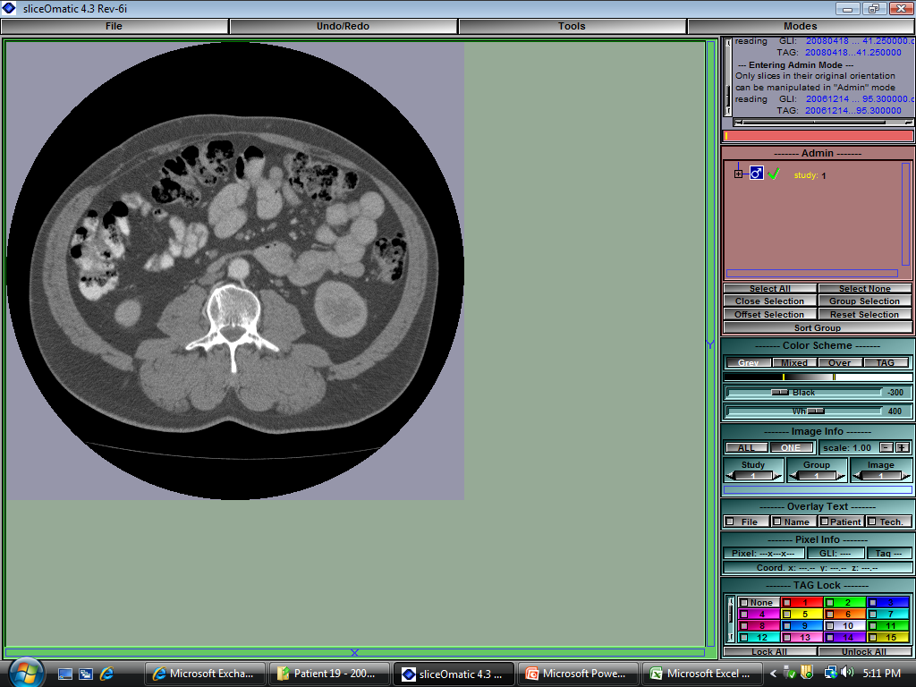
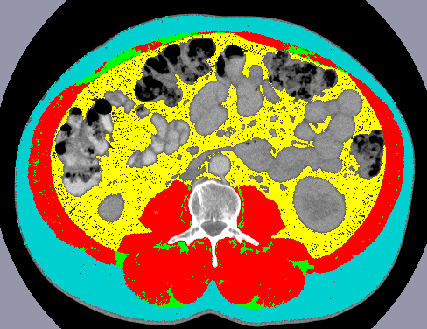
Body Composition Lab CT Analysis
Skeletal Muscle
Adipose Tissue
Images courtesy of Dr. Heyland
Notes:
To date we have used weight/BMI as a descriptor of patient body composition and we have looked at change in weight as a marker of change in nutritional status or to evaluate success/failure of nutritional intervention
However, with weight, we cannot discern specific body composition profile or changes in profile;
Use of already existing CT scans can provide this information…
-L3 bony landmark – literature; longitudinal

Slide 36
Skeletal Muscle is Related to Mortality in Critical Illness
Presence of sarcopenia associated with decreased ventilator-free days (P=0.004) and ICU-free days (0.002)
BMI, fat and serum albumin were not associated with ventilator- and ICU-free days
P=0.018
Moisey LL et al. Crit Care. 2013;17(5):R206.
Notes:
Multivariate linear regression showed that presence of sarcopenia decreased vent-free days and ICU-free days wehre BMI, fat and serum albumin did not.

Slide 37
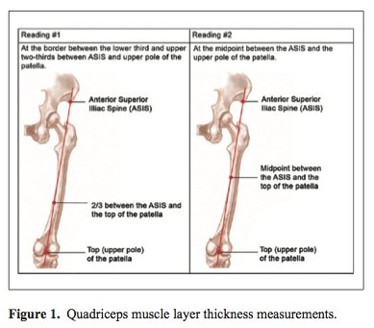
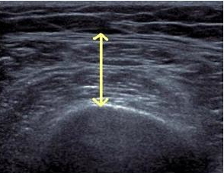
ICU Expedient Method
Tillquist et al JPEN 2013
Gruther et al. J Rehabil Med 2008
Campbell et al. AJCN 1995

Slide 38
VALIDation of bedside Ultrasound of Muscle layer thickness of the quadriceps in the critically ill patient: The VALIDUM Study
In a critically ill population, we aim to:
Evaluate intra- and (inter-) rater reliability of using ultrasound to measure QMLT.
Compare US-based quadriceps muscle layer thickness (QMLT) with L3 skeletal muscle cross-sectional area using CT.
Develop and validate a regression equation that uses QMLT acquired by ultrasound to predict whole body muscle mass estimated by CT
Notes:
Last night I introduced a validation study on US and DXA in healthy – here we examine ICU based US and CT

Slide 39
Study Design and Population
Prospective, observational study
Heterogeneous population of ICU inpatients
US performed within 72 hrs of CT scan
Inclusion Criteria:
  Abdominal CT scan performed for clinical reasons <24 hrs before or <72 hrs after ICU admission
Exclusion Criteria:
  Moribund patients with devastating injuries and not expected to survive

Slide 40
Participant Characteristics (n=149)
Characteristics | All patients (n=149)
Age (years) | 59±19 (18-96)
Sex
Male | 86 (57.7%)
BMI (kg/m²)* | 29± 8 (17-57)
Underweight | 4 (2.7%)
Normal | 43 (28.9%)
Overweight | 46 (30.9%)
Obesity class I | 56 (37.6%)
APACHE II score | 17± 8 ( 2-43)
SOFA score | 5± 4 ( 0-18)
Charlson comorbidity index | 2± 2 ( 0- 7)
Functional comorbidity index | 1± 1 ( 0- 4)
Characteristics | All patients (n=149)
Admission type
Medical | 87 (58.4%)
Surgical | 62 (41.6%)
Primary ICU admission
Cardiovascular/Vascular | 16 (10.7%)
Respiratory | 10 (6.7%)
Gastrointestinal | 26 (17.4%)
Neurologic | 6 (4.0%)
Sepsis | 56 (37.6%)
Trauma | 23 (15.4%)
Metabolic | 1 (0.7%)
Hematologic | 5 (3.4%)
Other | 6 (4.0%)
ICU mortality | 13 (8.7%)
Hospital mortality | 17 (11.4%)
Notes:
Of the n=191, 149 had usable CT scans, within the correct timeframe. As well as US performed within 72 hrs of CT scan.

Slide 41
Reliability Results
Intra-rater reliability of QMLT (n=119)*
  Between subject variance: 0.45
  Within Subject variance: 0.01
  ICC (intra-class correlation coefficient): 0.98
Inter-rater reliability of QMLT (n=29)
  Between subject variance: 0.42
  Within Subject variance: 0.03
  ICC (intra-class correlation coefficient): 0.94
Notes:
*Note: Not all patients had a repeat measurement and there was no restriction that the ultrasound had to be within 3 days of a CT scan for this analysis. This is why the “n” is different than above. Only the first observation pair was used in patients with multiple repeat observations.

Slide 42
  Descriptive Summary of CT Skeletal Muscle Mass and QMLT by Sex and Age
Measurement Mean ± SD | All patients (n=149) | Males (n=86) | Females (n=63) | p-value | Young (<65 years) (n=81) | Elderly (>65 years) (n=68) | p-value
Skeletal muscle index (cm²m²) | 49.0±13.6 | 55.1±13.2 | 40.6±9.1 | <.001 | 53.0±14.8 | 44.1±10.3 | <.001
Skeletal muscle cross sectional area (cm²) | 143.1±43.6 | 168.1±36.6 | 108.5±24.5 | <.001 | 157.4±45.6 | 126.0±34.1 | <.001
Left QMLT (cm) | 1.3±0.6 | 1.5±0.6 | 1.1±0.6 | <.001 | 1.4±0.7 | 1.2±0.5 | 0.41
Right QMLT (cm) | 1.3.±0.6 | 1.5±0.7 | 1.1±0.6 | <.001 | 1.4±0.7 | 1.3±0.6 | 0.65
50% prevalence of low muscularity defined by CT Threshold of <55.4 cm²/m² for males and <38.9 cm²/m² for females
Notes:
Describe the different measures
Why we included cm2/m2 as well as cm2 – becomes important in our results here as well as the BIA results
QMLT – the measures are v.low compared to non-Icu literature – but max compression used here…
QMLT – index – normalized to height squared – we have done this for consistency – is it redundant? Since we are evaluating pairs? Other papers have used limb length to formulate the thigh as a cylinder (which we don’t have but height might be the closest thing to it) → others have multiplied by limb length (and have resulted in stronger correlations)
- Difference between young and elderly may be driven by distribution of males and females in each group – we haven’t analyized this.
Skeletal muscle index (cm²/m²)
Calculated as Muscle CSA as cm2 divided by patient height squared as m2
Estimated whole body muscle mass (kg)
We have a regression equation that we use for this - it is not identified on the excel sheet
Left QMLT (cm)
Ultrasound-based quadricep muscle thickness in cm for the left leg
Right QMLT (cm)
Ultrasound-based quadricep muscle thickness in cm for the right leg
Left QMLT index
LEFT QMLT index divided by patient height squared in m2
Right QMLT index
RIGHT QMLT index divided by patient height squared in m2

Slide 43
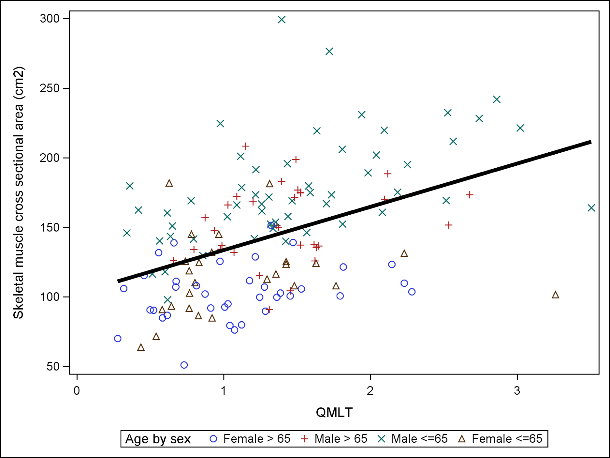
Association Between CT Skeletal Muscle CSA and US QMLT
Pearson correlation coefficient=0.45
P<0.0001
Notes:
Legend: Association between CT skeletal muscle cross sectional area and ultrasound QMLT with linear regression lines superimposed. Overall regression fit: CT skeletal muscle cross sectional area=102.5+31.1*QMLT. Overall Pearson correlation coefficient between CT skeletal muscle cross sectional area and Ultrasound QMLT index is 0.45, p<0.0001
Correlations were performed on each group but only males <65 yrs showed r=0.51 and P<0.05 (however this is likely driving the entire regression; n=?? but broad spectrum of muuscularity)
*Note: included 4 separate groups on the plot (young female, elderly female, young male, elderly male)
Groups
n
Pearson correlation coefficient
p values
Elderly males (≥ 65 yrs)
31
0.24
0.19
Young males (<65 yrs)
55
0.51
<0.0001
Elderly females (≥ 65 yrs)
37
0.26
0.12
Young females (<65 yrs)
26
0.13
0.52

Slide 44
    Ability of QMLT to Predict Low CT Skeletal Muscle Index and CSA by Logistic Regression
Outcome | Low MM/n | Predictors | c | P-value model | P-value QMLT
Low muscle index** | 74/149 | QMLT | 0.618 | 0.007 | 0.007
Low muscle index** | 74/149 | covariates* | 0.712 | 0.005 | NA
Low muscle index** | 74/149 | covariates + QMLT | 0.759 | <0.0001 | 0.0065
Low muscle area*** | 86/149 | QMLT | 0.666 | 0.0016 | 0.0016
Low muscle area*** | 86/149 | covariates* | 0.724 | 0.0008 | NA
Low muscle area*** | 86/149 | covariates + QMLT | 0.767 | <0.0001 | 0.0047
*Covariates are: age (linear), sex (binary), BMI (linear), Charlson comorbidity index (linear) and admission type (binary). **Low muscle index is defined as <55.4 cm²/m² for males and <38.9 cm²/m² for females. ***Low muscle area is defined at <170cm² for males and <110 cm² for females. Variance inflation factor for QMLT in model with all covariates is 1.2 NA – not applicable
Adapted from: Dodek PM, Wiggs BR. Resuscitation. 1998;36(3):201-8.
Notes:
Model is considered reasonable when c>0.7; strong when c>0.8 – moderately strong when combined covariates and QMLT – similar to previous slide using linear regression

Slide 45
Relationship between Sarcopenia and Frailty
Mueller N et al. Ann Surg. 2016;264(6):1116-1124.

Slide 46
Clinical Frailty Scale
Easier to operationalize
Predicts for poor outcome in ICU patients, particularly the elderly
May identify a subgroup of ‘high-risk’ patients that benefit from more nutrition?

Slide 48
Current Practice Results of 2014 INS
What are people prescribing currently?
Majority use actual or estimated dry weight
Goal protein requirement by weight (g/kg)
Median [Q1, Q3]
Site
1.5 [1.2-1.8]
All US sites (63)
1.3 [1.1-1.6]
All sites (186)
1.2 [1.0-1.5]
Notes:
Need data on use of protein supplements and percent with feeding protocols

Slide 49
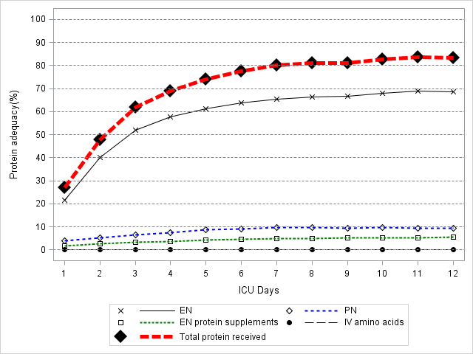
Current Practice Results of 2014 INS
Overall Adequacy 55%
Source of Protein
83% from EN
11.5% from PN
6% from enteral protein supplements
<1% from IV amino acids alone
Notes:
Need data on use of protein supplements and percent with feeding protocols

Slide 50
Current Practice Results of 2014 INS
In all comers:
At a patient level, 16% of patients averaged more than 80% protein adequacy
At a site level, 6% (11 sites) averaged more than 80% in all patients.
In High NUTRIC patients:
16% of high NUTRIC Score patients received more than 80% of prescribed amount.
7% (16 sites) managed to provide more than 80% of prescribed amounts to high-risk patients.
Performance in ‘all’ patients same as High NUTRIC patients

Slide 51

Is current practice providing adequate amounts of protein to critically ill patients? Particularly to ‘high-risk patients?

Slide 52
Start PEP uP Protocol in all Patients within 24-48 hrs of Admission
EN
YES
End of day 3:
NO
>
80% of goal?
Carry on!
High risk?*
Yes
No
Maximize EN with
Good job! Continue monitoring
ü
motility agents
nutritional adequacy!
ü
small bowel feeding
ü
protein supplements
NO
End of day 4:
YES
Tolerating
EN
>
80%?
Consider
Good job! Continue monitoring
supplemental PN
nutritional adequacy!
Heyland, Right here, Right now!

Slide 53
Who might benefit the most from nutrition therapy?
Clinical
  BMI
  Projected long length of stay
  Nutritional history variables
High NUTRIC Score
Low NUTRIC with risk factors
Sarcopenia
  CT vs. bedside US
  Frailty measures
Others?

