Slide 1


Slide 2
PEPuP POINTERS
Volume-Based Feeding:
Remember not to reduce rate of enteral feeding unless the gastric residual volume is >300 ml

Slide 3
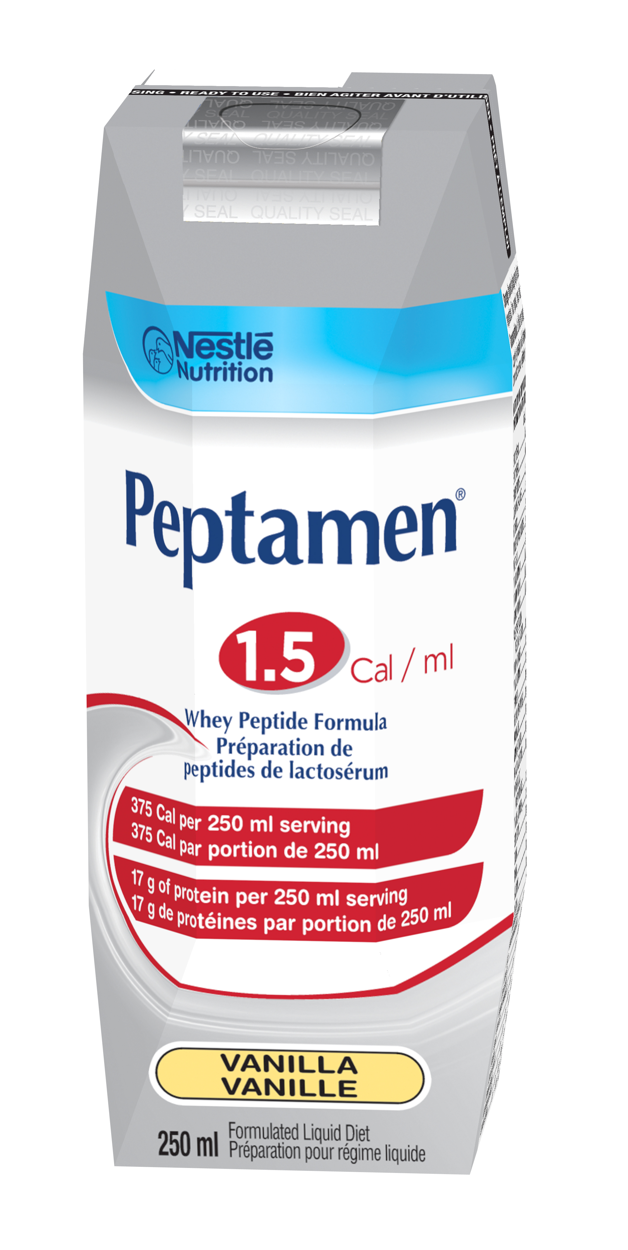
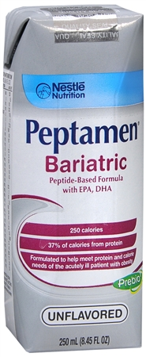
PEPuP POINTERS
All patients start on
a semi-elemental formula
(may reassess if needed)

Slide 4
PEPuP POINTERS
LOOSE STOOLS?
Don’t forget to use the study
diarrhea guideline

Slide 5
PEPuP POINTERS
All patients start on
Metoclopramide…
but reassess the need daily!

Slide 6

PEPuP POINTERS
AVOID THE PROTEIN DEFICIT!
All patients start
Beneprotein® on Day 1
2 packets mixed in 120 ml
sterile water bid

Slide 7
PEPuP POINTERS
Spread the good news!
Report on nutritional adequacy
at rounds each day

Slide 8

PEPuP POINTERS
Remember to fill in the reason
for NPO status
on the enteral order form

Slide 9

PEPuP POINTERS
Good enteral feeding practice
means thinking ahead!
DON’T FORGET
to account for held hours
in your feeding rate calculation

Slide 10
PEPuP POINTERS
TROPHIC FEEDING:
Start a semi-elemental formula
at 10 mL/h.
Do not monitor
gastric residual volumes.

Slide 11
PEPuP POINTERS
DON’T FORGET
to use the Gastric Feeding Flow Chart to help follow the protocol for gastric residual volumes!

