Slide 1


Slide 2
PRESENTATION OBJECTIVES
Review the:
  importance of adequate enteral nutrition
  use of volume based feeding protocols - PEP uP
  PEP uP trial results
Highlight key features of the PEP uP protocol
and how this would work in your ICU
Review case studies which illustrate use of the PEP uP protocol
in critically ill patients

Slide 3
ADEQUATE NUTRITION
Provides fuel for cellular metabolism
Prevents protein/muscle wasting
Decreases ventilator time
Helps prevent infection/VAP
Decreases ICU length of stay
Promotes healthy wound healing
Reduces mortality

Slide 4
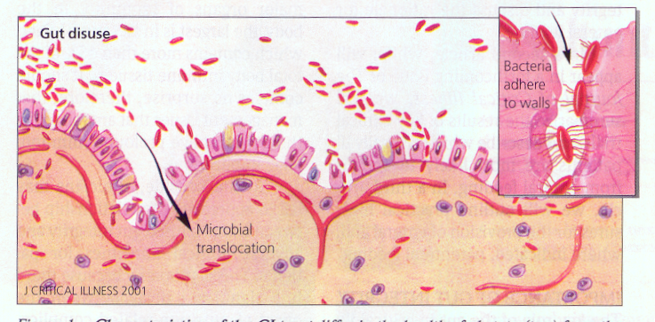
JUST SAY NO TO NPO
Gut disuse causes loss of functional and structural integrity of the GI tract
and is associated with increased complications
These changes are time dependent:
  - The longer patients are left NPO, the greater the complications

Slide 5
Our ICU has adopted the
PEP uP PROTOCOL
Main Objective:
To enhance protein and energy
provision via the enteral route
in critically ill patients

Slide 6

PEP uP is being used
MORE FREQUENTLY
18 sites across North America participated in the cRCT
The main outcome was adequacy of enteral feeding delivery,
but also:
    - No safety concerns
    were reported
    - Nurses reported that
    they found the protocol
    acceptable

Slide 7
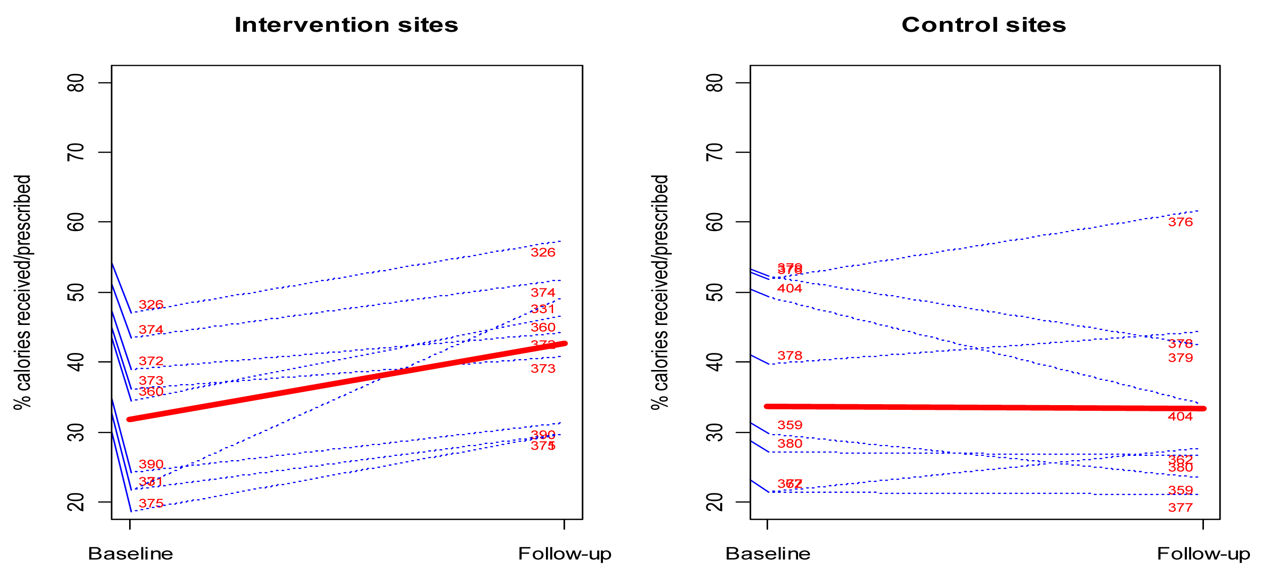
CHANGE OF NUTRITIONAL INTAKE from baseline to follow-up of all the Study Sites
(ALL PATIENTS)
p value = 0.001
p value = 0.71
% calories received/prescribed

Slide 8
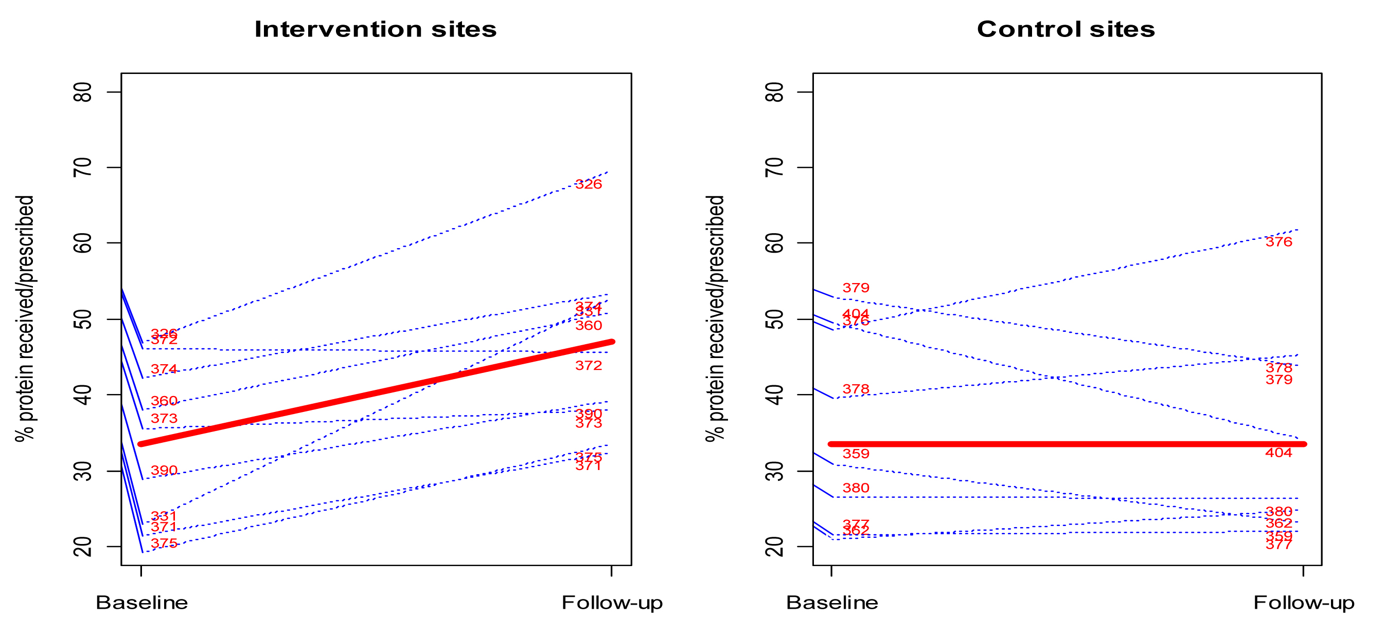
CHANGE OF NUTRITIONAL INTAKE from baseline to follow-up of all the Study Sites
(ALL PATIENTS)
p value = 0.005
p value = 0.81
% protein received/prescribed

Slide 9
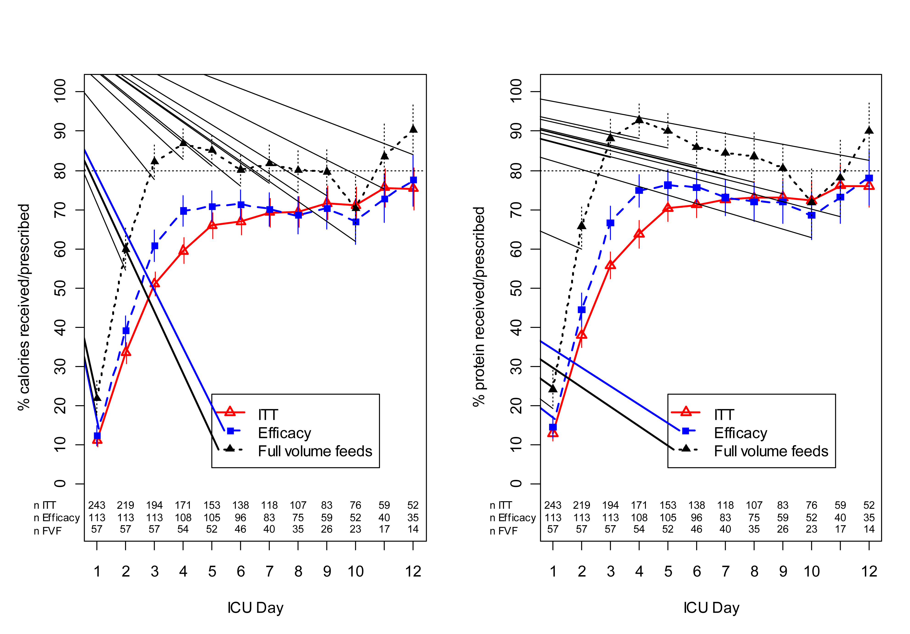
DAILY PROPORTION OF PRESCRIPTION RECEIVED by EN in ITT Efficacy and full volume feeds subgroups
(AMOUNG PATIENTS IN THE INTERNETION FOLLOW-UP PHASE)

Slide 10
MAIN FEATURES
OF THE PEP uP PROTOCOL
All patients will receive a semi-elemental formula initially
All patients will start on Beneprotein®
  2 packets (14 g) mixed in 120ml water administered bid via NG
All patients will be given metoclopramide
on day 1 of enteral feeding
  10 mg IV q 6h
* Reassess formula, protein supplement, and motility agent daily

Slide 11
GET PEPPED UP!
OPTION 1: Begin Volume-Based feeds
24 hour period begins at XX:XX h daily
Patients receive a semi-elemental formula initially
Day 1: start feeding at 25 mL/hr
Day 2: Feeding rate determined by 24hr target volume
Consult dietitian to calculate 24hr target volume
(if RD not available, use weight based goal until patient assessed)
Determine hourly rate as per Volume Based Feeding Schedule
Monitor gastric residual volumes as per Gastric Feeding Flowchart
and Volume Based Feeding Schedule

Slide 12

WHAT IS VOLUME BASED FEEDING?
Based on a 24 hour volume total rather than an hourly rate
Initial infusion rate is determined by dividing the total by 24
Hourly rate may be changed during the day due to interruptions (i.e. tests, surgery)
to achieve the 24 hour volume total
During daily rounds, nursing report will include the percentage of feeds the patient received the previous day
GOAL: to improve nutrition in ICU patients

Slide 13
GET PEPPED UP!
OPTION 2: Trophic feeds
Begin a semi-elemental formula at 10 mL/h
after initial tube placement confirmed
Do not monitor gastric residual volumes
Reassess ability to transition to
Volume-Based feeds next day
2 tsp per hour

Slide 14
GET PEPPED UP!
OPTION 2: Trophic feeds
Intended for patient who is:
On vasopressors (regardless of dose) as long as they are adequately resuscitated
Not suitable for high volume enteral feeding:
  Ruptured AAA
  Surgically placed jejunostomy
  Upper intestinal anastomosis
  Impending intubation

Slide 15
GET PEPPED UP!
OPTION 3: NPO
Only if contraindication to EN present: bowel perforation,
bowel obstruction, proximal high output fistula.
Recent operation and high NG output
are not a contraindication to EN.
Reassess ability to transition to Volume-Based feeds next day.

Slide 16
GASTRIC FEEDING FLOWCHART

Slide 17
CASE STUDY
A 35-year old male was admitted at 04:00 h
following a gunshot wound to the chest.
His injuries include massive trauma to right arm, left chest and left shoulder. He experienced 3 intra-operative cardiac arrests.

Slide 18
CASE STUDY: ADMISSION
On arrival to the ICU he is in pulmonary edema, right heart failure, vasopressin at 0.04 units/hr and his levophed continues
to be titrated up to maintain a MAP of 60 mmHg; the current
rate is 25 mcg/min.
He is approximately 70 Kg and 1.74 m tall.

Slide 19
CASE STUDY: ADMISSION
On admission you inform the medical team that the patient is NPO. Which of the following interventions
do you anticipate?
  Continue NPO
  Volume based enteral feeds
  Enteral feeds at 25/hr
  Trophic feeds

Slide 20

CASE STUDY: ADMISSION
On admission you inform the medical team that the patient is NPO. Which of the following interventions
do you anticipate?
  Continue NPO
  Volume based enteral feeds
  Enteral feeds at 25/hr
  Trophic feeds

Slide 21
CASE STUDY: DAY 1
He is oliguric, and his creatinine and urea continue to rise. What dose of metoclopramide will you administer?
  Metoclopramide 10 mg q6h
  Metoclopramide 5 mg q6h
  Metoclopramide 10 mg q8h
  Metoclopramide not indicated

Slide 22
CASE STUDY: DAY 1
He is oliguric, and his creatinine and urea continue to rise. What dose of metoclopramide will you administer?
  Metoclopramide 10 mg q6h
  Metoclopramide 5 mg q6h
  Metoclopramide 10 mg q8h
  Metoclopramide not indicated

Slide 23
CASE STUDY: DAY 2
Levophed and vasopressin are discontinued
His enteral feeds are at 10 mL/hr

Slide 24
CASE STUDY: DAY 2 – Morning Rounds
On morning rounds you inform the medical team that the patient no longer requires vasopressor support and is receiving trophic feeds. What intervention do you anticipate?
  Increase trophic rate from 10 to 20 mL/hr
  Start enteral feeds at 25 mL/hr and increase to target of 70 mL/hr
  Start volume feeds at a target goal rate determined by dietitian
  Start volume feeds at 1100 ml over 24 hours

Slide 25
CASE STUDY: DAY 2 – Morning Rounds
On morning rounds you inform the medical team that the patient no longer requires vasopressor support and is receiving trophic feeds. What intervention do you anticipate?
  Increase trophic rate from 10 to 20 mL/hr
  Start enteral feeds at 25 mL/hr and increase to target of 70 mL/hr
  Start volume feeds at a target goal rate determined by dietitian
  Start volume feeds at 1100 mls over 24 hours

Slide 26
CASE STUDY: DAY 2 – Gastric Residuals
At 08:00 you measured the gastric residual volume and it is 350 mL. You replace the aspirate and continue feeding at target goal rate. At 12:00 his gastric residuals are measured again and it remains at 350 mL. What will you do?
  Replace 300 mL of aspirate and decrease rate by 50 mL/hr
  Replace all the aspirate and maintain current feeding rate
  Replace 300 mL of aspirate and decrease rate by 25 mL/hr
  Do not replace aspirate and hold tube feeds

Slide 27
CASE STUDY: DAY 2 – Gastric Residuals
At 08:00 you measured the gastric residual volume and it is 350 mL. You replace the aspirate and continue feeding at target goal rate. At 12:00 his gastric residuals are measured again and it remains at 350 mL. What will you do?
  Replace 300 mL of aspirate and decrease rate by 50 mL/hr
  Replace all the aspirate and maintain current feeding rate
  Replace 300 mL of aspirate and decrease rate by 25 mL/hr
  Do not replace aspirate and hold tube feeds

Slide 28
CASE STUDY: DAYS 3 & 4
He remains stable throughout Day 3
On Day 4 of his admission the surgical team informs
you at 10:00 h that they will be taking him back to the OR
They request that he be kept NPO after 24:00 hours

Slide 29
CASE STUDY: DAYS 3 & 4
What do you expect to do with his feeds?
  Recalculate the rate so that you can provide
  the rest of the daily goal volume by midnight
  Increase the rate by 25 mL/hr
  Decrease the rate by 25 mL/hr
  Do nothing

Slide 30
CASE STUDY: DAYS 3 & 4
What do you expect to do with his feeds?
  Recalculate the rate so that you can provide
  the rest of the daily goal volume by midnight
  Increase the rate by 25 mL/hr
  Decrease the rate by 25 mL/hr
  Do nothing

Slide 31
CASE STUDY: RETURNING TO THE OR
The dietitian has determined that his daily volume goal is 1200 ml in 24 hours (starts at 07:00 daily) which is a rate of 50 mL/hr. Based on the 24 hour volume protocol, what will be his new rate to reach his goal volume by midnight based on a 1.5 kcal/ml formula?
  64 mL/hr
  75 mL/hr
  82 mL/hr
  96 mL/hr

Slide 32
CASE STUDY: RETURNING TO THE OR
The dietitian has determined that his daily volume goal is 1200 ml in 24 hours (starts at 07:00 daily) which is a rate of 50 mL/hr. Based on the 24 hour volume protocol, what will be his new rate to reach his goal volume by midnight based on a 1.5 kcal/ml formula?
  64 mL/hr
  75 mL/hr
  82 mL/hr
  96 mL/hr

Slide 33
CASE STUDY: HOURLY RATE?
What is the maximum hourly rate that you should infuse
on volume based feeding?
  125 mL/hr
  135 mL/hr
  150 mL/hr
  160 mL/hr

Slide 34
CASE STUDY: HOURLY RATE?
What is the maximum hourly rate that you should infuse
on volume based feeding?
  125 mL/hr
  135 mL/hr
  150 mL/hr
  160 mL/hr

Slide 35
CASE STUDY:
REPORTING DAILY NUTRITION
Your 24 hour intake indicates that he received 1100 mL in the last 24 hours. Based on the daily goal of 1200 mL in 24 hours, what will you report as his nutritional adequacy during morning rounds?
  92%
  94%
  96%
  98%

Slide 36
CASE STUDY:
REPORTING DAILY NUTRITION
Your 24 hour intake indicates that he received 1100 mL in the last 24 hours. Based on the daily goal of 1200 mL in 24 hours, what will you report as his nutritional adequacy during morning rounds?
  92%
  94%
  96%
  98%

Slide 37
CASE STUDY:
GASTRIC RESIDUALS - AGAIN
He continues to receive 5mg metoclopramide as per the enteral feeding initiation orders. His gastric residuals have been more than 300 mL for 2 consecutive checks.
What intervention do you anticipate?
  Consider Erythromycin 200 mg Q12h
  Increase Metoclopramide to 10 mg q4h
  Increase rate of feeds
  Hold feeds for 4 hours

Slide 38
CASE STUDY:
GASTRIC RESIDUALS - AGAIN
He continues to receive 5mg metoclopramide as per the enteral feeding initiation orders. His gastric residuals have been more than 300 mL for 2 consecutive checks.
What intervention do you anticipate?
  Consider Erythromycin 200 mg Q12h
  Increase Metoclopramide to 10 mg q4h
  Increase rate of feeds
  Hold feeds for 4 hours

Slide 39
CASE STUDY: ONE WEEK LATER
He is scheduled for an MRI at 14:00 h. The enteral feeds are stopped from 14:00 hours to 17:00 hours.
His volume target is 1200 mL in 24 hours which is a rate of
50 mL/hr. Upon returning to the ICU at 17:00 h, what will be his new rate for the remaining time based on a 1.5 kcal/ml formula?
  60 mL/hr
  65 mL/hr
  70 mL/hr
  75 mL/hr

Slide 40
CASE STUDY: ONE WEEK LATER
He is scheduled for an MRI at 14:00 h. The enteral feeds are stopped from 14:00 hours to 17:00 hours.
His volume target is 1200 mL in 24 hours which is a rate of
50 mL/hr. Upon returning to the ICU at 17:00 h, what will be his new rate for the remaining time based on a 1.5 kcal/ml formula?
  60 mL/hr
  65 mL/hr
  70 mL/hr
  75 mL/hr

Slide 41


