Slide 1
Daren K. Heyland, MD, MSc, FRCPC
Professor of Medicine
Queen’s University, Kingston General Hospital
Kingston, Ontario

Slide 2
Disclosure of Potential
Conflicts of Interest
I have received research grants and speaker
honoraria from the following companies:
  Nestlé Canada
  Fresenius Kabi AG
  Baxter
  Abbott Laboratories

Slide 3

Objectives
Describe optimal amounts of protein/calories
required for ICU patients
Describe rationale for the novel components
of the PEP uP protocol and evidence for effectiveness
Describe the experience implementing this protocol in ICUs in North America

Slide 4
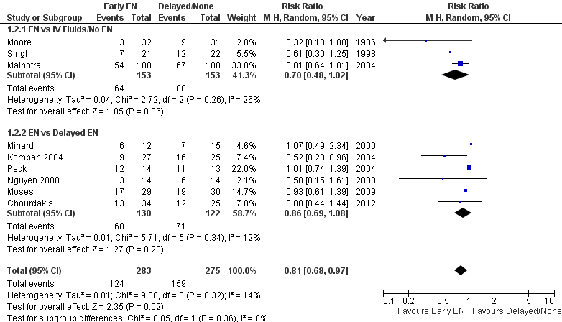
Early vs. Delayed EN:
Effect on Infectious Complications
Updated 2013 www.criticalcarenutrition.com

Slide 5
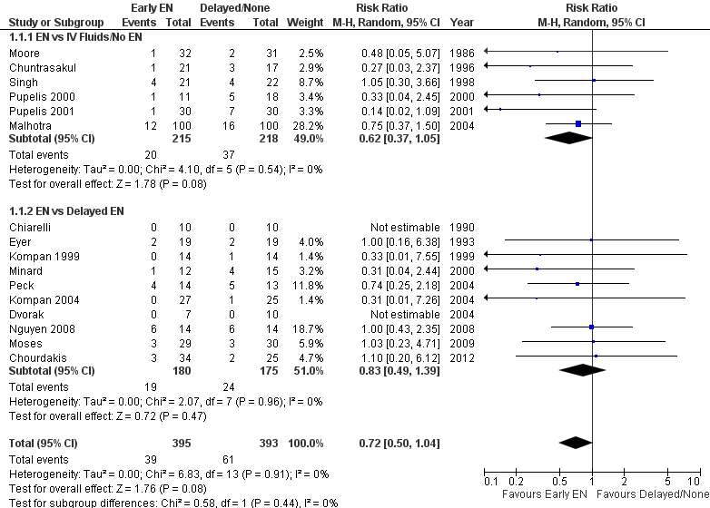
Early vs. Delayed EN: Effect on Mortality
Updated 2013 www.criticalcarenutrition.com

Slide 6
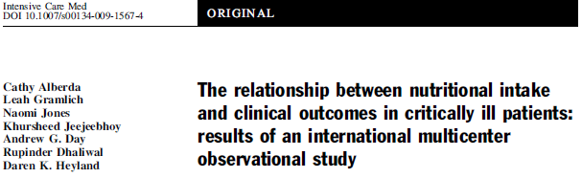
Point prevalence survey of nutrition practices in ICU’s around the world conducted Jan. 27, 2007
Enrolled 2772 patients from 158 ICU’s over 5 continents
Included ventilated adult patients who remained in ICU >72 hours

Slide 8
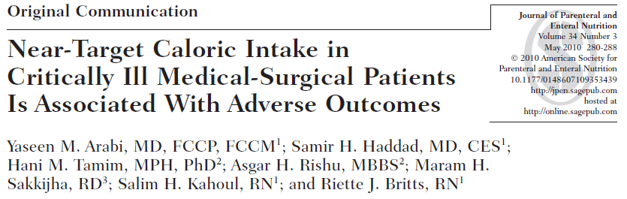
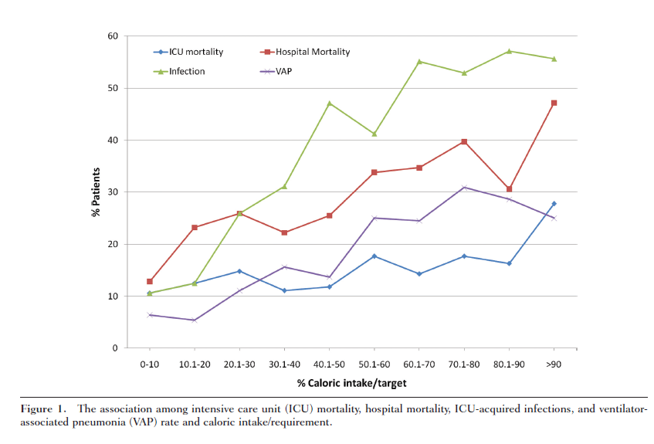

Slide 9
Optimal Amount of Calories for Critically Ill Patients: Depends on how you slice the cake!
Objective: To examine the relationship between the amount of calories received and mortality using various sample restriction and statistical adjustment techniques and demonstrate the influence of the analytic approach on the results.
Design: Prospective, multi-institutional audit
Setting: 352 Intensive Care Units (ICUs) from 33 countries.
Patients: 7,872 mechanically ventilated, critically ill patients who remained in ICU for at least 96 hours.
Heyland DK, et al. Crit Care Med. 2011;39(12):2619-26.

Slide 10
Association between 12 day average caloric adequacy and
60 day hospital mortality
(Comparing patients rec’d >2/3 to those who rec’d <1/3)
A. In ICU for at least 96 hours. Days after permanent progression to exclusive oral feeding are included as zero calories*
B. In ICU for at least 96 hours. Days after permanent progression to exclusive oral feeding are excluded from average adequacy calculation.*
C. In ICU for at least 4 days before permanent progression to exclusive oral feeding. Days after permanent progression to exclusive oral feeding are excluded from average adequacy calculation.*
D. In ICU at least 12 days prior to permanent progression to exclusive oral feeding*
*Adjusted for evaluable days and covariates,covariates include region (Canada, Australia and New Zealand, USA, Europe and South Africa, Latin America, Asia), admission category (medical, surgical), APACHE II score, age, gender and BMI.

Slide 11
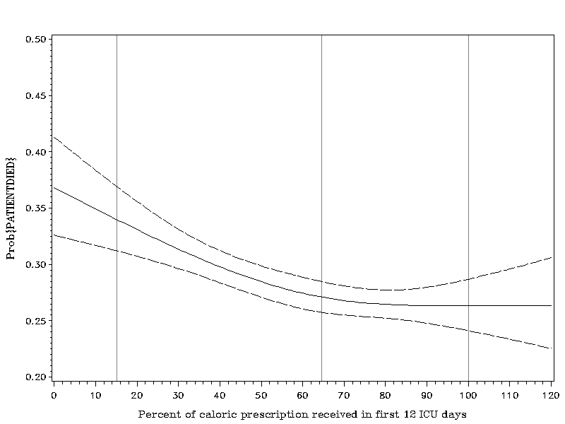
Optimal Amount of Calories for Critically Ill Patients: Depends on how you slice the cake!
Association Between 12-day Caloric Adequacy
and 60-day Hospital Mortality
Optimal amount =
80-85%
Heyland DK, et al. Crit Care Med. 2011;39(12):2619-26.

Slide 12
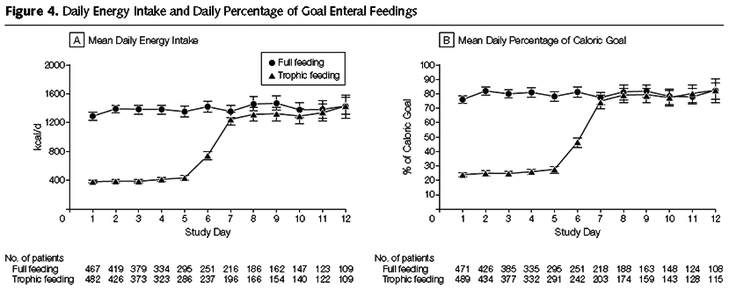
Initial Tropic vs. Full EN in Patients with Acute Lung Injury
The EDEN randomized trial
Rice TW, et al. JAMA. 2012;307(8):795-803.

Slide 13
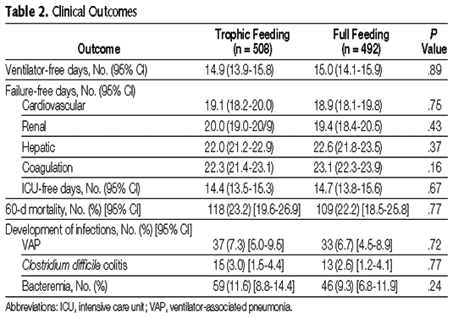
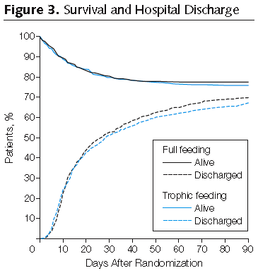
Initial Tropic vs. Full EN in Patients with Acute Lung Injury
The EDEN randomized trial
Rice TW, et al. JAMA. 2012;307(8):795-803.

Slide 14
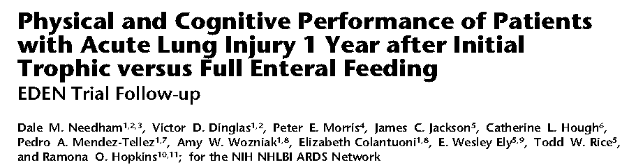
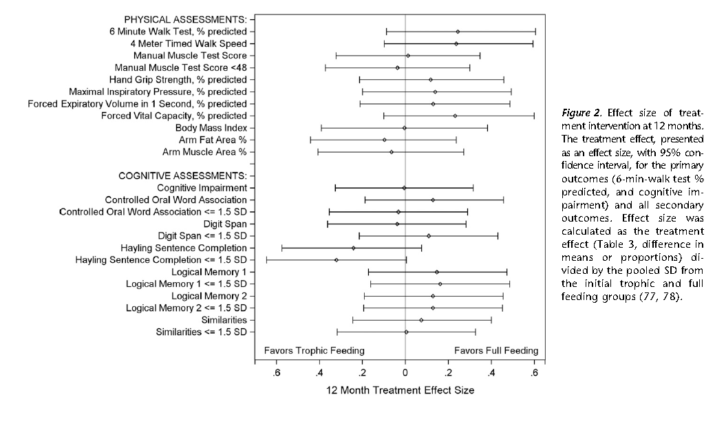

Slide 15
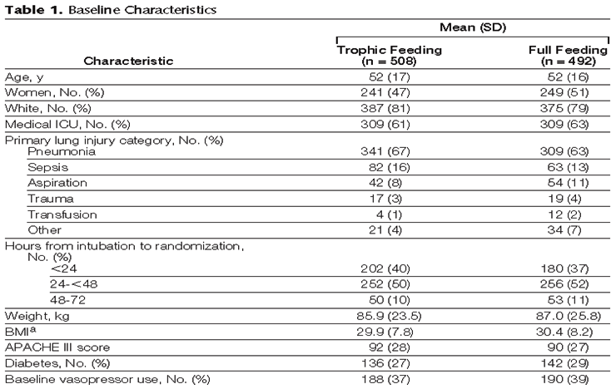
Initial Tropic vs. Full EN in Patients with Acute Lung Injury
The EDEN randomized trial
Enrolled 12% of patients screened
Rice TW, et al. JAMA. 2012;307(8):795-803.

Slide 16
Trophic vs. Full EN in Critically Ill Patients with Acute Respiratory Failure
Average age 52
Few comorbidities
Average BMI* 29-30
All fed within 24 hours (benefits of early EN)
Average duration of study intervention 5 days
No effect in young, healthy,
overweight patients who have short stays!
Heyland DK. Critical care nutrition support research: lessons learned from recent trials.
Curr Opin Clin Nutr Metab Care 2013;16:176-181.

Slide 17
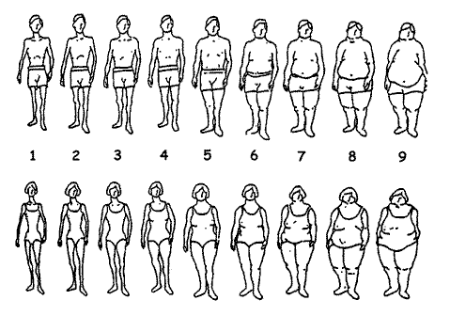
ICU Patients Are Not All Created Equal…
Should we expect the impact of nutrition therapy to be the same across all patients?

Slide 18
A Conceptual Model for
Nutrition Risk Assessment in the Critically Ill
Acute
Reduced po intake
pre ICU hospital stay
Chronic
Recent weight loss
BMI?
Starvation
Nutrition Status
micronutrient levels - immune markers - muscle mass
Acute
IL-6
CRP
PCT
Inflammation
Chronic
Comorbid illness
Heyland DK, et al. Crit Care. 2011;15(6):R268.

Slide 19
The Development of the NUTrition Risk in the Critically ill Score (NUTRIC Score).
Variable | Range | Points
Age | <50 | 0
 | 50-<75 | 1
 | >=75 | 2
APACHE II | <15 | 0
 | 15-<20 | 1
 | 20-28 | 2
 | >=28 | 3
SOFA | <6 | 0
 | 6-<10 | 1
 | >=10 | 2
# Comorbidities | 0-1 | 0
 | 2+ | 1
Days from hospital to ICU admit | 0-<1 | 0
 | 1+ | 1
IL6 | 0-<400 | 0
 | 400+ | 1
AUC | 0.783
BMI, CRP, PCT, weight loss, and oral intake were excluded because they were not significantly associated with mortality or their inclusion did not improve the fit of the final model.

Slide 20
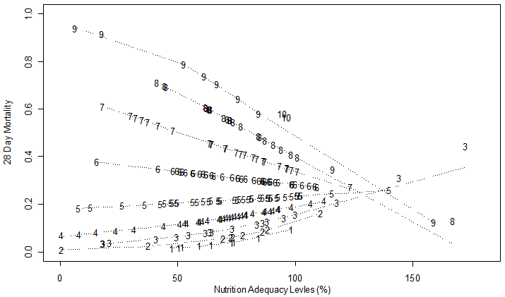
High Nutrition Risk Patients Benefit from More EN Whereas Low Risk Do Not
Interaction Between NUTRIC Score and Nutritional Adequacy (n = 211)*
p-value for the interaction = 0.01
Heyland DK, et al. Crit Care. 2011;15(6):R268.

Slide 21

More (and Earlier) is Better for High Risk Patients!
If you feed them (better!)
They will leave (sooner!)

Slide 22
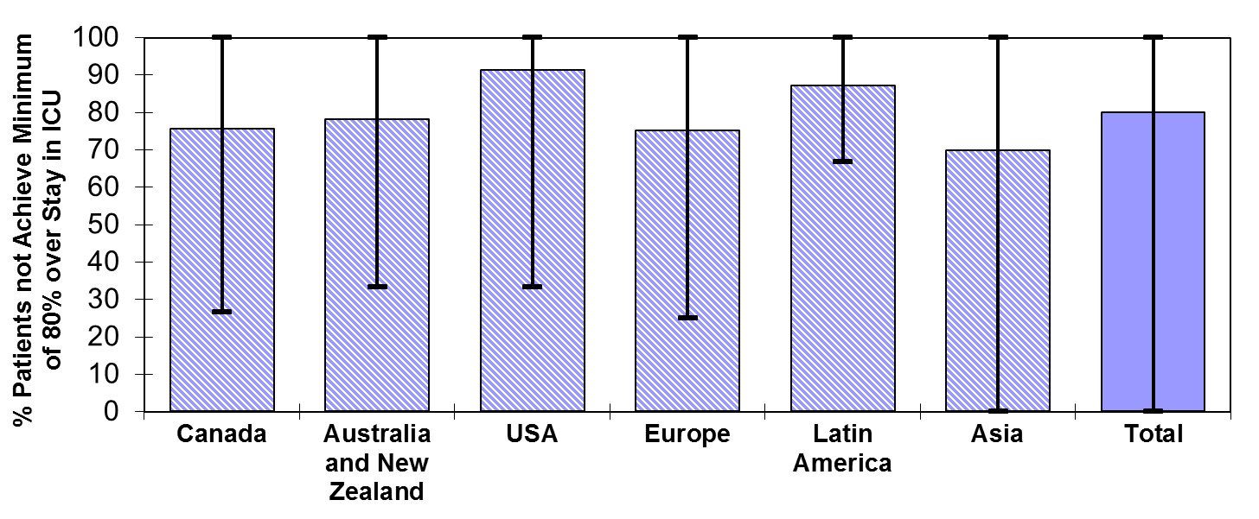
Failure Rate
% high risk patients who failed to meet minimal quality targets (80% overall energy adequacy)
91.2
87.0
75.6
78.1
75.1
79.9
69.8
Heyland 2013 (in submission)

Slide 23
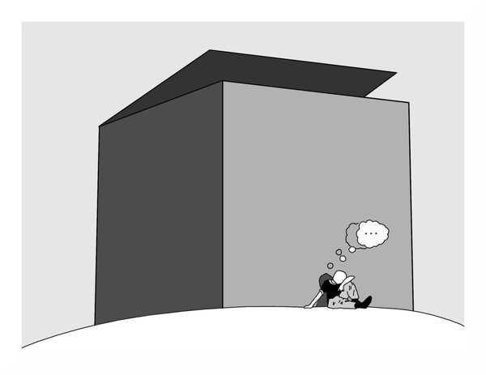
Can we do better?
The same thinking that got you into
this mess won’t get you out of it!

Slide 24

The Efficacy of Enhanced Protein-Energy Provision via the Enteral Route in Critically Ill Patients:
The PEP uP Protocol!
Different feeding options based on hemodynamic stability
and suitability for high volume intragastric feeds.
In select patients, we start the EN immediately at goal rate,
not at 25 ml/hr.
We target a 24 hour volume of EN rather than an hourly
rate and provide the nurse with the latitude to increase
the hourly rate to make up the 24 hour volume.
Start with a semi elemental solution, progress to polymeric.
Motility agents and protein supplements are started
immediately, rather than started when there is a problem.
Tolerate higher GRV* threshold (300 ml or more).
A major paradigm shift in how we feed enterally
* GRV: gastric residual volume
Heyland DK, et al. Crit Care. 2010;14(2):R78.

Slide 25
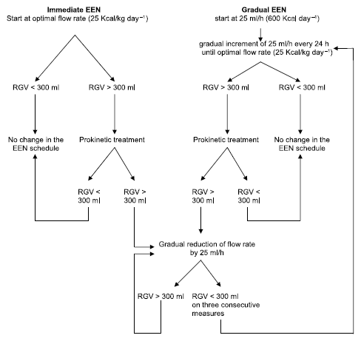
Initial Efficacy and Tolerability of Early EN with
Immediate or Gradual Introduction in Intubated Patients
This study randomized
100 mechanically ventilated patients (not in shock) to immediate goal rate vs.
gradual ramp up
(our usual standard).
The immediate goal group
received more calories with
no increase in complications.
Desachy A, et al. Intensive Care Med. 2008;34(6):1054-9.

Slide 26
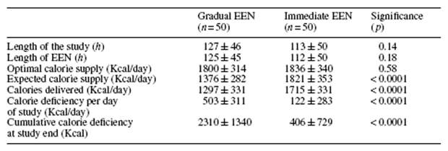
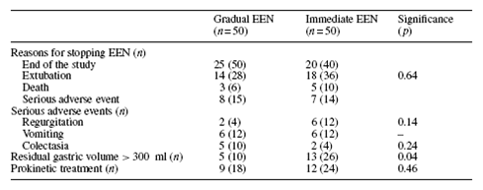
Initial Efficacy and Tolerability of Early EN with
Immediate or Gradual Introduction in Intubated Patients
Desachy A, et al. Intensive Care Med. 2008;34(6):1054-9.

Slide 27
Rather Than Hourly Goal Rate, We Changed to a 24 Hour Volume-based Goal. Nurse Has
Responsibility to Administer That Volume over the 24 Period with the Following Guidelines
If the total volume ordered is 1,800 ml the hourly amount to feed
is 75 ml/hour.
If patient was fed 450 ml of feeding (6 hours) and the tube feeding
is on “hold” for 5 hours, then subtract from goal volume the amount
of feeding patient has already received.
  Patient now has 13 hours left in the day to receive 1,350 ml of tube feeding.
  Divide remaining volume over remaining hours (1,350 ml/13 hours) to determine
  new hourly goal rate.
  Round up so new rate would be 105 ml/hr for 13 hours.
  The following day, at shift change, the rate drops back to 75 ml/hour.
  Volume ordered per 24 hours 1,800 ml - tube feeding in (current day) 450 ml
  = Volume of feeding remaining in day to feed.
  (1,800 ml - 450ml = 1,350 ml remaining to feed)

Slide 28
What about feeding the hypotensive patient?
Resuscitation is the priority
No sense in feeding someone dying of
progressive circulatory failure
However, if resuscitated yet remaining
on vasopressors:
Safety and efficacy of EN??

Slide 29
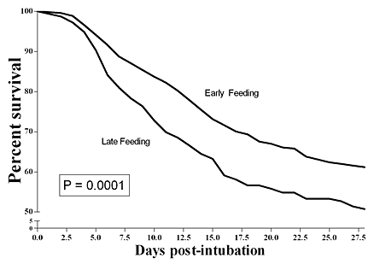

Feeding the hypotensive patient?
Prospectively collected multi-institutional ICU database of 1,174 patients who required mechanical ventilation for more than two days and were on vasopressor agents to support blood pressure.
The beneficial effect of early feeding is more evident in
the sickest patients, i.e., those on multiple vasopressor agents.
Khalid I, et al. Am J Crit Care. 2010;19(3):261-8.

Slide 30
“Trophic Feeds”
Just say no
to NPO*
Progressive atrophy of villous height and crypt depth in absence of EN.
Leads to increased permeability
and decreased IgA** secretion.
Can be preserved by a minimum
of 10-15% of goal calories.
Observational study of 66 critically
ill patients suggests TPN† + trophic feeds associated with reduced infection and mortality compared
to TPN alone¹.
A = No EN; B = 100% EN
* NPO: nothing per os; ** IgA: immunoglobulin A;
† TPN: total parenteral nutrition.
¹Marik. Crit Care & Shock. 2002;5:1-10;
Ohta K, et al. Am J Surg. 2003;185(1):79-85.

Slide 31
Why 1.5 Cal Semi-Elemental Formula:
A “Safe Start”
Impaired GI motility and absorption is common in critically ill patients ^{1,2}
Semi-elemental formulas may help improve tolerance and absorption ^{3,4}
Whey protein considered a “fast protein”^{5,6,7}
  May facilitate gastric emptying
Concentrated formula 1.5 kcals/mL to improve nutrition intake
= “Safe Start” on admission to ICU
1. Ukleja A. NCP. 2010; 25(1):16-25 2. Abrahao V. Curr Op Clin Nutr Met Care 2012; 15:480-84 3. Merideth. J Trauma 1990. 4. McClave. JPEN 2009; 33(3): 277-316. 5. Boirie Y et al. Proc Natl Acad Science. 1997; 94 : 14930–5. 6. Dangin M. J Nutr. 2002; S3228-33. 7. Aguilar-Nascimento. J Nutr. 2011;27:440-4.

Slide 32
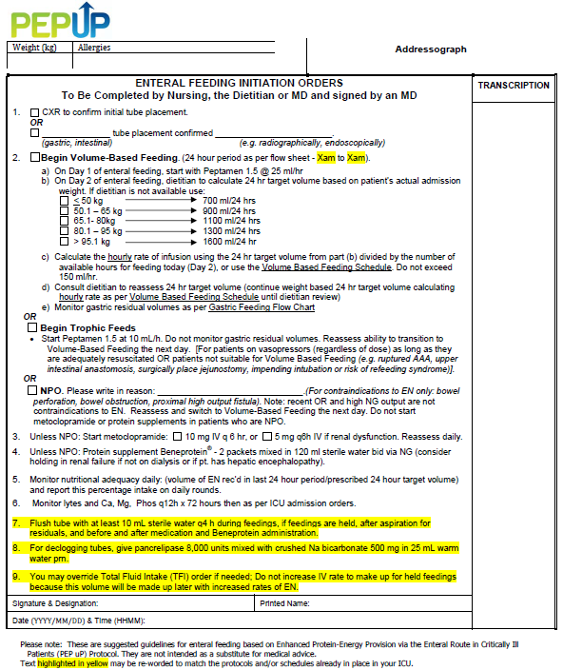

Slide 33

It’s Not Just About Calories...
Inadequate protein intake
Loss of lean muscle mass
Immune dysfunction
Weak prolonged
mechanical ventilation
So in order to minimize this, we order:
Protein supplement Beneprotein® 14 grams mixed
in 120 mls sterile water administered BID via NG
Hoffer
Am J Clin Nutr
2012;96:591

Slide 34
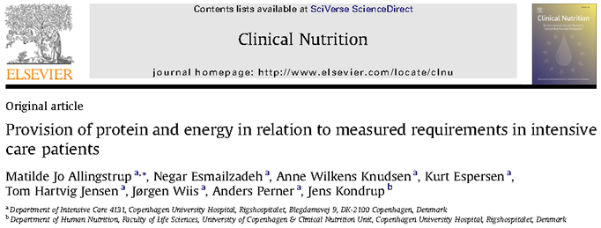
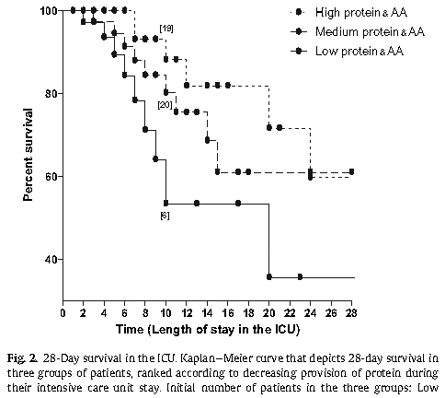
113 select ICU patients with sepsis
or burns
On average, receiving 1,900 kcal/day and 84 grams of protein
No significant relationship with
energy intake but…
Allingstrup MJ, et al. Clin Nutr. 2012;31(4):462-8.

Slide 35
Pro-motility Agents
Conclusion:
Motility agents have no effect on mortality or
infectious complications in critically ill patients.
Motility agents may be associated with an increase
in gastric emptying, a reduction in feeding intolerance
and a greater caloric intake in critically ill patients.
“Based on 1 level 1 study and 5 level 2 studies,
in critically ill patients who experience feed
intolerance (high gastric residuals, emesis),
we recommend the use of a pro-motility agent”.
2009 Canadian CPGs
www.criticalcarenutrition.com

Slide 36
Other Strategies to Maximize the Benefits and Minimize the Risks of EN
Motility agents started at initiation of EN rather
that waiting till problems with high GRV develop.
  Maxeran® 10 mg IV q 6h (halved in renal failure)
  If still develops high gastric residuals,
  add erythromycin 200 mg q 12h
  Can be used together for up to 7 days
  but should be discontinued when not
  needed any more
  Reassess need for motility agents daily

Slide 37
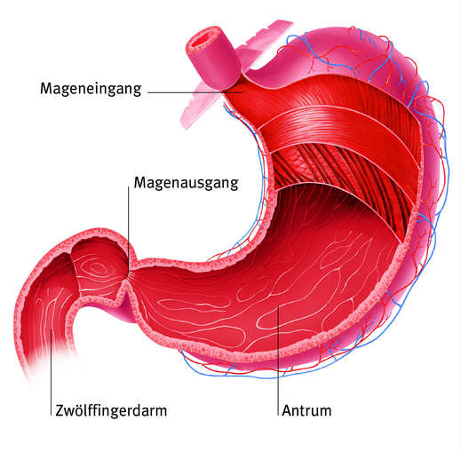


Why measure GRV?
Cardia
GI motility disorders are frequent (up to 80%)
Delayed gastric emptying in
  50% of artificially ventilated patients
  up to 80% in patients with severe sepsis, burn injury or polytrauma
GRV as a surrogate marker to detect GI disorders and avoid risk of aspiration and pneumonia due to regurgitation/vomiting of gastric contents
Pylorus
Duodenum
Antrum
Ukleja A. Nutr Clin Pract. 2010;25:16-25 Lopez-Herce J. Curr Opin Clin Nutr Metab Care. 2009;12:180-5
Notes:
What is the rationale?
The pathophysiology is multifactorial including the severity and etiology of the underlying critical illness, use of narcotic analgesia and other sedatives, decreased blood flow from shock, and use of vasopressors. Gastric dysmotility results in delayed gastric emptying that may place patients at risk of developing complications such as vomiting, aspiration, and ventilator associated pneumonia (VAP).

Slide 38
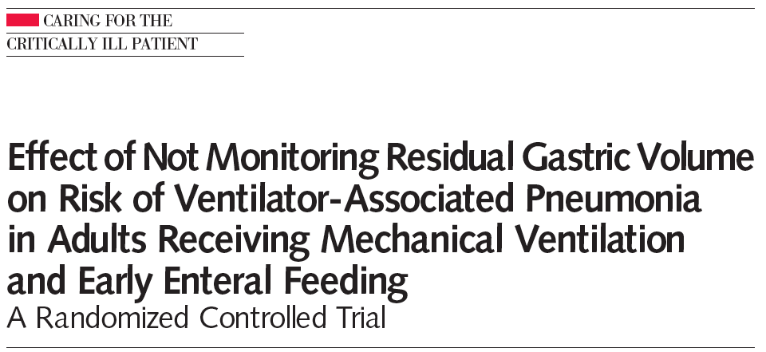
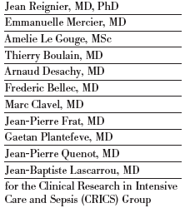
Challenging the role of monitoring GRV
Randomized non-inferiority, open-label, multicenter trial in 9 ICUs in France
449 ICU patients mechanically ventilated >48 hrs and started on EN via a nasogastric tube within 36 hrs
Intervention (No GRV monitoring)
  EN intolerance diagnosed by vomiting defined as gastric contents detected in the oropharynx or outside the mouth including spontaneous regurgitation of EN
Control (GRV monitoring)
  EN intolerance diagnosed by vomiting, GRV >250 mL measured every 6hrs by aspiration, or both
Primary outcome
  Proportion of patients with at least 1 VAP episode
Reignier et al. JAMA. 2013;309:249-56
Notes:
With increasing thresholds the question always arose whether GRV should be measured at all.
Evidence challenging the general role of monitoring GRV comes in France! Before I go into detail regarding these two studies, you should know, that in general, we do love of our neighbours!
Largest study that truly compared not measuring vs measuring!
449 ICU patients expected to require >48 hrs of invasive mechanical ventilation, and started on EN via a nasogastric tube within 36 hrs

Slide 39
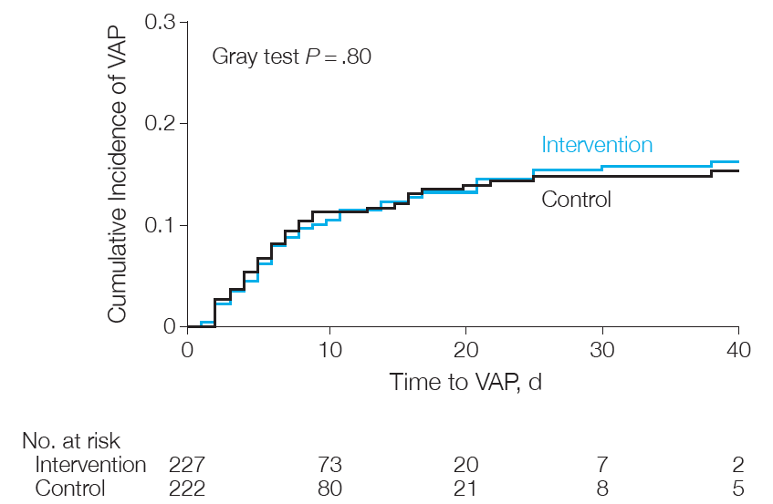
Main Results
No significant differences
other ICU-acquired infections
mechanical ventilation duration
ICU stay length or mortality rates
Notes:
VAP-Kriterien willkürlich, definition hinschreiben

Slide 40
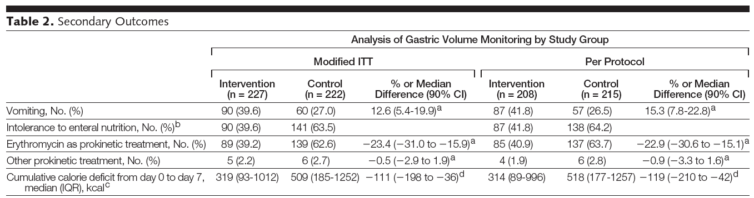
Main Results
No GRV
No GRV
Reignier et al. JAMA. 2013;309:249-56
Notes:
aggressive feeding protocol the investigators used, whereby enteral feedings were started at goal rates and titrated down when feeding intolerances were experienced.
However, the proportion of patients meeting the groupspecific definition of enteral nutrition intolerance was higher in the control group, which also had a higher proportion of patients given the prokinetic agent erythromycin. The calorie target was achieved in a higher proportion of patients in the intervention group than in those in the control group (FIGURE 3; modified ITT OR, 4.13; 90% CI, 2.20-7.69; P.001; per-protocol OR, 4.95; 90% CI, 2.59-9.12; P.001). Consequently, patients in the intervention group had a lower cumulative calorie deficit from day 0 to day 7 compared with patients in the control group (Table 2). The rates of diarrhea and ICU-acquired infections did not differ between groups (Table 2).

Slide 41
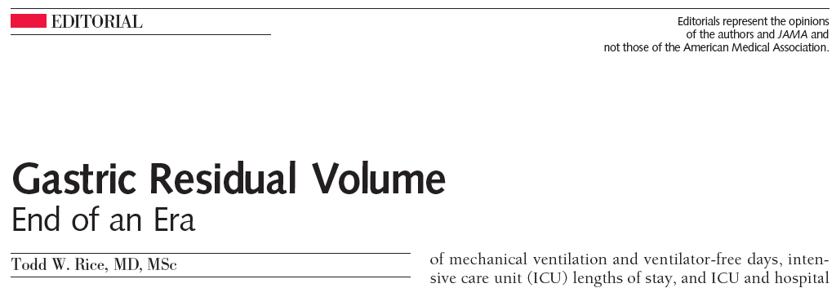
“Residual gastric volume monitoring should be removed from the standard care of critically ill patients receiving invasive mechanical ventilation and early enteral nutrition.”
Reignier et al. JAMA. 2013;309:249-56
Rice TW. JAMA. 2013;309:283-4
Dellinger et al. Crit Care Med 2013; 41:580-637
Notes:
So this most recent study results prompted the authors as well as Todd Rice to the statement

Slide 42
Limitations of the Regenier Trial
Lack of blinding
Limited generalizability
  >85% medical patients
  ? Patients in shock
When protocolizing care, need to consider the heterogeneity of patients and plan for the most difficult patients
Still check GRV (250-500)

Slide 43
A Change to Nursing Report
Please report this % on rounds as part of the GI systems report
Adequacy of nutrition support
=
24 hour volume of EN received
Volume prescribed to meet caloric
requirements in 24 hours

Slide 44

When performance is measured,
performance improves.
When performance is
measured and reported back,
the rate of improvement accelerates.
Thomas Monson

Slide 45
Efficacy of Enhanced Protein-Energy Provision via the Enteral Route in
Critically Ill Patients: The PEP uP Protocol
A multi-center cluster randomized trial
Daren K. Heyland
Professor of Medicine
Queen’s University
Kingston General Hospital
Kingston, Ontario
Critical Care Medicine Aug 2013

Slide 46

Research Questions
Primary: What is the effect of the new innovative feeding
protocol, the Enhanced Protein-Energy Provision via
the Enteral Route Feeding Protocol (PEP uP protocol),
combined with a nursing educational intervention on
EN intake compared to usual care?
Secondary: What is the safety, feasibility and acceptability of
the new PEP uP protocol?
Our hypothesis is that this aggressive feeding protocol combined
with a nurse-directed nutrition educational intervention will be safe, acceptable, and effectively increase protein and energy delivery to critically ill patients.

Slide 47
Design
Control
18 sites
6-9 months later
Baseline
Follow-up
Intervention
Protocol utilized in all patient mechanically intubated within
the first 6 hours after ICU admission
Focus on those who remained mechanically ventilated > 72 hours
Notes:
IT IS OK, I VERBALIZE IT CORRECTLY

Slide 48
Tools to Operationalize the PEP uP Protocol
Bedside Written Materials | Description
EN initiation orders | Physician standardized order sheet for starting EN.
Gastric feeding flow chart | Flow diagram illustrating the procedure for management of gastric residual volumes.
Volume-based feeding schedule | Table for determining goal rates of EN based on the 24 hour goal volume.
Daily monitoring checklist | Excel spreadsheet used to monitor the progress of EN.
Materials to Increase Knowledge and Awareness
Study information sheets | Information about the study rationale and guidelines for implementation of the PEP uP protocol. Three versions of the sheets were developed targeted at nurses, physicians, and patients’ family, respectively.
PowerPoint presentations | Information about the study rationale and how to implement the PEP uP protocol. A long (30-40 minute) and short (10-15 minute) version were available.
Self-learning module | Information about the PEP uP protocol and case example to work through independently.
Posters | A variety of posters were available to hang in the ICU during the study.
Frequently Asked Questions (FAQ) document | Document addresses common questions about the PEP uP Protocol.
Electronic reminder messages | Animated reminder messages about key elements of the PEP uP protocol to be displayed on a monitor in the ICU.
Monthly newsletters | Monthly circular with updates about the study.

Slide 49
Analysis
3 overall analyses:
  ITT* involving all patients (n = 1,059)
  Efficacy analysis involving only those that
  remain mechanically ventilated for > 72 hours
  and receive the PEP uP protocol (n = 581)
  Those initiated on volume-based feeds
* ITT: intention to treat
Notes:
YES, PLEASE DO

Slide 50
Participating Sites
 | Intervention (n = 9) | Control (n = 9) | p-values
Hospital type Teaching Non-teaching | 4 (44.4%) 5 (55.6%) | 4 (44.4%) 5 (55.6%) | 1.00
Size of hospital (beds) Mean (range) | 396.9 (139.0, 720.0) | 448.7 (99.0, 1000.0) | 0.97
ICU structure Open Closed | 3 (33.3%) 6 (66.7%) | 4 (44.4%) 5 (55.6%) | 1.00
Case type Medical Neurological Surgical Neurosurgical Trauma Cardiac surgery Burns Other | 9 (40.9%) 3 (13.6%) 5 (22.7%) 2 (9.1%) 1 (4.5%) 0 (0.0%) 1 (4.5%) 1 (4.5%) | 9 (36.0%) 2 (8.0%) 8 (32.0%) 2 (8.0%) 2 (8.0%) 1 (4.0%) 1 (4.0%) 0 (0.0%) | 0.97
Size of ICU (beds) Mean (range) | 12.6 (7.0, 20.0) | 16.3 (8.0,25.0) | 0.12
Full time equivalent dietician (per 10 beds) Mean (range) | 0.5 (0.3, 0.9) | 0.4 (0.0, 0.6) | 0.76
Regions Canada USA | 4 (44.4%) 5 (55.6%) | 5 (55.6%) 4 (44.4%) | 1.00
Notes:
50

Slide 51
Patient Characteristics
(n = 1,059)
 | Intervention |  | Control
 | Baseline | Follow-up | Baseline | Follow-up | p-value
n | 270 | 252 | 270 | 267
Age Mean ± SD | 65.1 ± 15.5 | 64.1 ± 16.7 | 63.4 ± 15.1 | 61.4 ± 16.2 | 0.45
Sex Male (%) | 157 (58.1%) | 137 (54.4%) | 170 (63.0%) | 173 (64.8%) | 0.56
Admission category Medical Elective surgery Emergent surgery | 230 (85.2%) 14 (5.2%) 26 (9.6%) | 222 (88.1%) 12 (4.8%) 18 (7.1%) | 213 (78.9%) 23 (8.5%) 34 (12.6%) | 212 (79.4%) 23 (8.6%) 30 (11.2%) | 0.24
Admission diagnosis Cardiovascular/vascular Respiratory Gastrointestinal Neurologic Sepsis Trauma Metabolic Hematologic Other non-operative conditions Renal-operative Gynecologic-operative Orthopedic-operative Other operative conditions | 40 (14.8%) 110 (40.7%) 35 (13.0%) 19 (7.0%) 37 (13.7%) 0 (0.0%) 11 (4.1%) 1 (0.4%) 7 (2.6%) 2 (0.7%) 1 (0.4%) 1 (0.4%) 6 (2.2%) | 43 (17.1%) 112 (44.4%) 19 (7.5%) 19 (7.5%) 20 (7.9%) 2 (0.8%) 15 (6.0%) 0 (0.0%) 15 (6.0%) 0 (0.0%) 0 (0.0%) 1 (0.4%) 6 (2.4%) | 31 (11.5%) 78 (28.9%) 29 (10.7%) 30 (11.1%) 57 (21.1%) 17 (6.3%) 13 (4.8%) 0 (0.0%) 5 (1.9%) 0 (0.0%) 0 (0.0%) 1 (0.4%) 9 (3.3%) | 51 (19.1%) 81 (30.3%) 29 (10.9%) 28 (10.5%) 25 (9.4%) 18 (6.7%) 6 ( 2.2%) 1 (0.4%) 7 (2.6%) 3 (1.1%) 1 (0.4%) 3 (1.1%) 12 (4.5%) | undescribed
APACHE II score Mean ± SD | 23.0 ± 7.2 | 23.5 ± 7.1 | 21.1 ± 7.3 | 21.1 ± 7.3 | 0.53
Notes:
yes

Slide 52
Clinical Outcomes
(All patients – n = 1,059)
 |  | Intervention |  | Control |  | p-value
 |  | Baseline | Follow-up | Baseline | Follow-up
Length of ICU stay (days)* | Median (IQR†) | 6.1 (3.4,11.1) | 7.2 (3.4,11.1) | 6.4 (3.3,12.6) | 5.7 (2.8,11.8) | 0.35
Length of hospital stay (days)* | Median (IQR) | 14.2 (8.1,29.8) | 13.5 (8.1,28.4) | 16.7 (7.5,27.7) | 13.8 (7.1,26.6) | 0.73
Length of mechanical ventilation (days)* | Median (IQR) | 3.7 (1.6,9.1) | 4.3 (1.3,9.9) | 3.1 (1.4,8.4) | 3 (1.4,7.3) | 0.57
Patient died within 60 days of ICU admission | Yes | 70 (25.9%) | 68 (27.0%) | 65 (24.1%) | 63 (23.6%) | 0.53
* Based on 60-day survivors only. Time before ICU admission is not counted.
† IQR: interquartile range
Notes:
fixed

Slide 53
Change of Nutritional Intake from Baseline to Follow-up of All the Study Sites (All patients)
% Calories Received/Prescribed
p value=0.001
p value=0.71

Slide 54
Change of Nutritional Intake from Baseline to Follow-up of All the Study Sites (All patients)
% Protein Received/Prescribed
p value=0.005
p value=0.81

Slide 55
Daily Proportion of Prescription Received by EN in ITT,
Efficacy and Full Volume Feeds Subgroups
(Among Patients in the Intervention Follow-up Phase)
Notes:
Too late

Slide 56
Compliance with PEP uP Protocol Components (All patients n = 1,059)
Percent
Difference in Intervention baseline vs. follow up and vs. control all <0.05

Slide 57
Complications
(All patients – n = 1,059)
Percent
Vomiting
Regurgitation
Macro Aspiration
Pneumonia
p > 0.05

Slide 58
Nurses’ Ratings of Acceptability
 | After Group Mean (Range)
24 hour volume based target | 8.0 (1-10)
Starting at a high hourly rate | 6.0 (1-10)
Starting motility agents right away | 8.0 (1-10)
Starting protein supplements right away | 9.0 (1-10)
Acceptability of the overall protocol | 8.0 (1-10)
1 = totally unacceptable and 10 = totally acceptable
McCall M NCP 2014 (in press)

Slide 59
Usage of PEP uP Training Components
Training Method | % of Respondents Who Received Method | % Somewhat Useful + Very Useful
PP at critical care rounds | 35% | 88.6%
PP by intranet or email | 25% | 55.2%
PP at inservices | 65% | 80.7%
Bedside small group instruction | 24% | 75.6%
Bedside 1-on-1 instruction | 28% | 77.7%
Self learning module | 45% | 76.2%
Bedside letter to staff | 24% | 48.6%
Study posters | 60% | 67.2%
Computer screensaver | 14% | 47.0%
McCall M NCP 2014 (in press)

Slide 60
Barriers to Implementation
Difficulties embed into EMR*
Non-comprehensive dissemination
of educational tools
Facilitators to Implementation
Involvement of nurse educator
(nurses owned it)
Ongoing bedside encouragement
and coaching by site dietitian
* EMR: electronic medical records

Slide 61
PEP uP Trial Conclusion
Statistically significant improvements in
nutritional intake
  Suboptimal effect related to suboptimal implementation
Safe
Acceptable
Merits further use
Can successfully be implemented in a broad
range of ICUs in North America

Slide 62
Canadian PEP uP Collaborative
National Quality improvement collaborative in conjunction with Nestle
What we provide
All participating sites will receive:
access to an educational DVD presentation to train your multidisciplinary team
supporting tools such as visual aids and protocol templates
access to a member of the Critical Care Nutrition team who will support each site during the collaborative
access to an online discussion group around questions unique to PEP uP
a detailed site report, showing nutrition performance, following participation in the International Nutrition Survey 2013
online access to a novel nutrition monitoring tool we have developed
Tools, resources, contact information are available at criticalcarenutrition.com

Slide 63


Education and Awareness Tools
PEP uP Pocket Guide
PEP uP Poster

Slide 64

Nursing Education Video

Slide 65
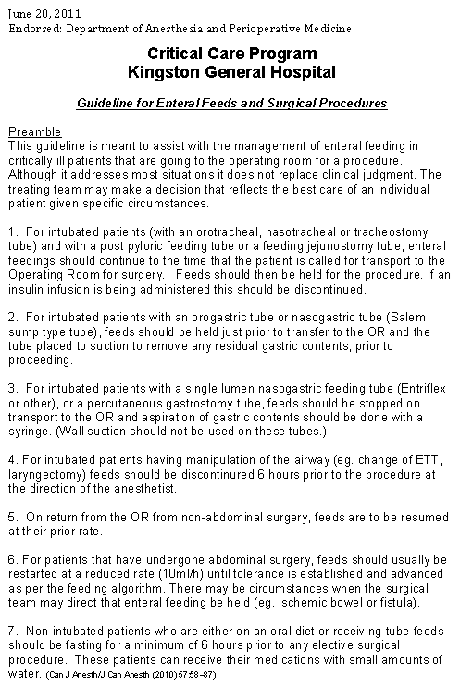
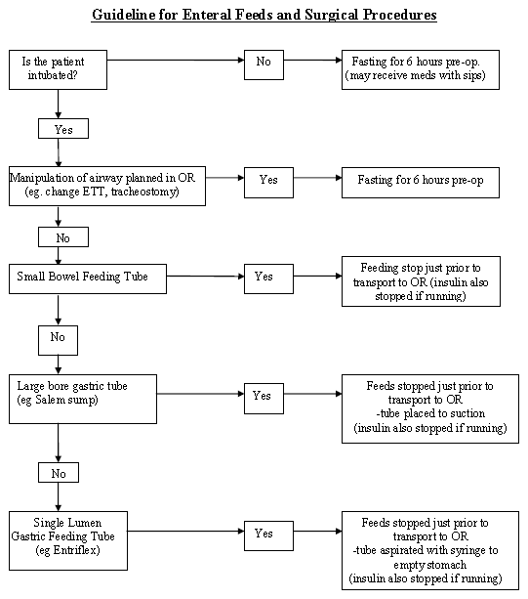
Protocol to Manage Interruptions to EN Due to Non-GI Reasons
Can be downloaded from www.criticalcarenutrition.com

Slide 66
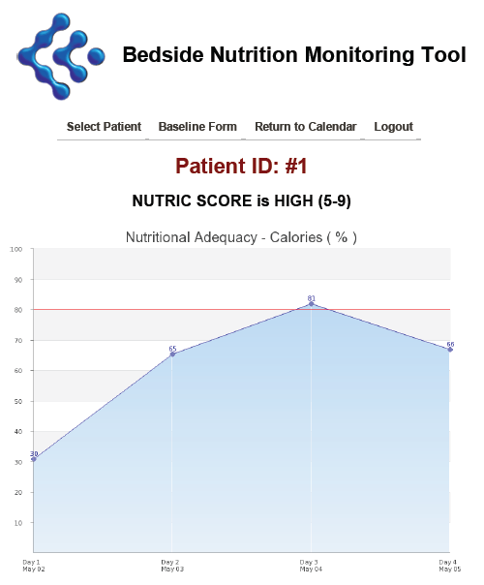

PEP uP Monitoring Tool

Slide 67
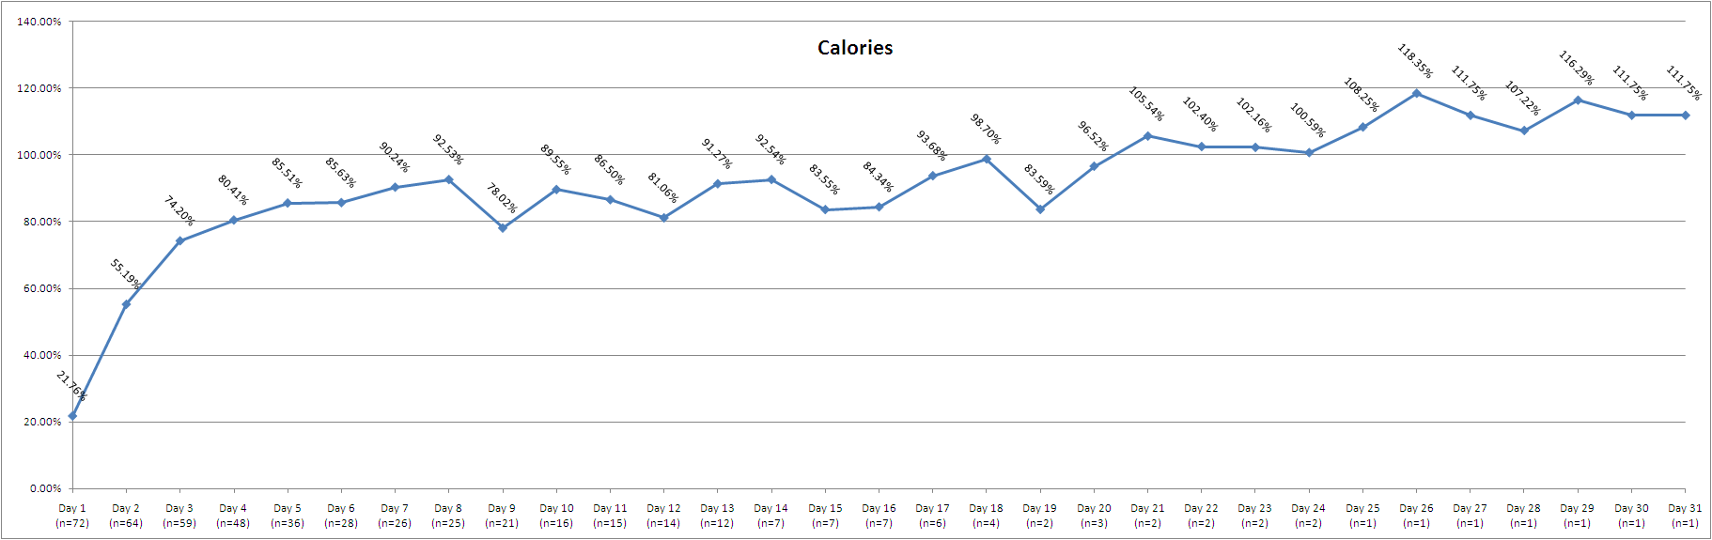
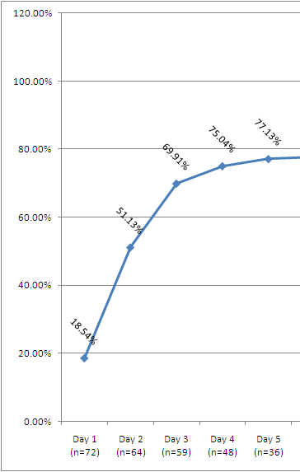


Bedside Nutrition Monitoring Tool: A Preliminary Review
September 2012 – April 2013
Sites using the tool:
Site | Number of patients entered (n=76) | Number of days using the tool
Credit Valley Hospital* | 37 | 256
Cape Breton Regional Hospital* | 20 | 168
UHNBC* | 8 | 41
Rapid City Regional Hospital* | 6 | 7
William Osler HS – Etobicoke* | 3 | 2
McGill University | 1 | 3
St. Michael's Hospital | 1 | 9
We will analyze the Bedside Nutrition monitoring Tool data quarterly. Access the tool online here.
*PEP uP Collaborative sites
Average of the nutrition data entered on all patients per day
Good work! By day 3, we see about 74% of calories and 70% of protein being delivered, which is a significant improvement from the data we have seen in our surveys.
With the use of protein supplements in the PEP uP protocol, we expect protein adequacy to be higher than calorie adequacy. We are interested in learning:
Adequacy of calories delivered
Adequacy of protein delivered
Is your ICU using protein supplements starting on day 1?
If no, what barriers are preventing you from providing protein supplements?
If yes, are you providing 24g of protein per day from protein supplements?
How can we help you increase protein adequacy? Please bring your answers to the conference call in May!

Slide 68
Results of the Canadian PEP uP Collaborative
8 ICUs implemented PEP uP protocol through Fall of 2012-Spring 2013
Compared to 16 ICUs (concurrent control group)
All evaluated their nutrition performance in the context of INS 2013
Heyland JPEN 2014 (in press)

Slide 69
Results of the Canadian PEP uP Collaborative
 | PEP uP Sites (n=8) | Concurrent Controls (n=16) | P values*
Number of patients | 154 | 290
Proportion of prescribed calories from EN
Mean±SD | 60.1% ± 29.3% | 49.9% ± 28.9% | 0.02
Proportion of prescribed protein from EN
Mean±SD | 61.0% ± 29.7% | 49.7% ± 28.6% | 0.01
Proportion of prescribed calories from total nutrition
Mean±SD | 68.5% ± 32.8% | 56.2% ± 29.4% | 0.04
Proportion of prescribed protein from total nutrition
Mean±SD | 63.1% ± 28.9% | 51.7% ± 28.2% | 0.01

Slide 70
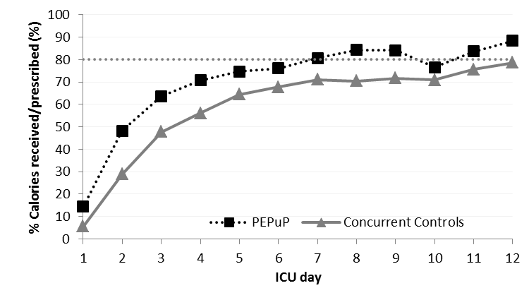
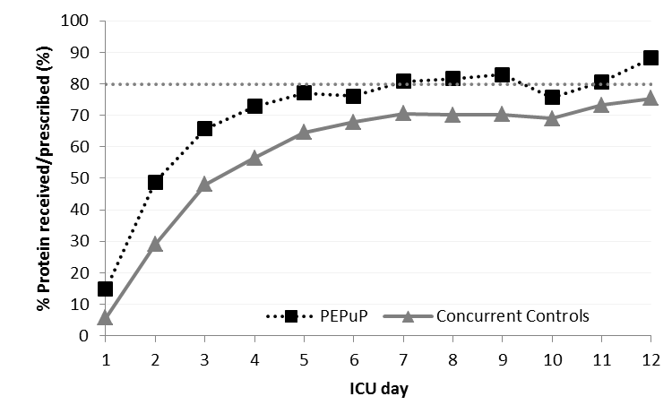
Results of the Canadian PEP uP Collaborative

Slide 71
Results of the Canadian PEP uP Collaborative
Average Caloric Adequacy Across Sites
Average Protein Adequacy Across Sites

Slide 72
Results of the Canadian PEP uP Collaborative
Proportion of Prescribed Energy From EN According to Initial EN Delivery Strategy
Just say no
to NPO*
Notes:
Need to update with new slide

Slide 73
Results of the Canadian PEP uP Collaborative
Proportion of Prescribed Protein From EN According to Initial EN Delivery Strategy
Just say no
to NPO*
Notes:
Need to update with new slides

Slide 74
Results of the Canadian PEP uP Collaborative
Patients in PEP uP Sites were much more likely to*:
  receive protein supplements (72% vs. 48%)
  receive 80 % of protein requirements by day 3 (46% vs. 29%)
  receive Semi- or elemental solution within first 2 days of admission (45% vs. 7%)
  receive a motility agent within first 2 days of admission (55% vs. 10%)
No difference in glycemic control
*All comparisons are statistically significant p<0.05

Slide 75
Major Barriers to Protocol Implementation
Time consuming local approval process
Continuing education efforts for nursing staff
Changing the ICU culture
Concern regarding the use of motility agents
Concern regarding patients at risk of refeeding syndrome

Slide 76
Comments from Participating ICUs
Most of the staff like [the protocol]…but it is always a work in progress. If the pressure is let up, the protocol doesn't work. There is no one doing surveillance and hence the TF delivery is suboptimal. Pumps are not cleared at the appropriate time, rates not adjusted, etc.
The resources and support provided by the Critical Care Nutrition Team are absolutely amazing.
All the educational material/handouts/information has been very useful (and essential) in implementing this protocol in our unit
The NIBBLES articles have been fantastic in providing information to our unit and our MDs
Regarding the Red Cap software for the INS data collecton, it was very glitchy!

Slide 77
Conclusions
PEP uP protocol can be successfully implemented in real practice setting in Canada with no/limited additional resources provided

Slide 78
Next Steps
Initiate US PEP uP collaborative Spring 2014
Application for Nestle support were due Feb 16, 2014
See our website for details
Other countries interested?

Slide 79
Start PEP uP
Day 3
> 80%
of goal calories
Yes
No
Carry on!
High
risk?
Yes
No
Maximize EN with motility agents
and small bowel feeding
No problem
Not
tolerating
EN at
96 hrs?
Yes
No
Supplemental PN?

Slide 80
In Summary, I Have…
Described optimal amounts of protein/calories
required for ICU patients
Described the rationale for the novel components
of the PEP uP protocol
Described strategies to effectively implement
this protocol in your ICU

Slide 81
Thank you for your attention.
Questions?

