Slide 1
Daren K. Heyland, MD, MSc, FRCPC
Professor of Medicine
Queen’s University, Kingston General Hospital
Kingston, Ontario

Slide 2

More (and Earlier) is Better for High Risk Patients!
If you feed them (better!)
They will leave (sooner!)

Slide 3
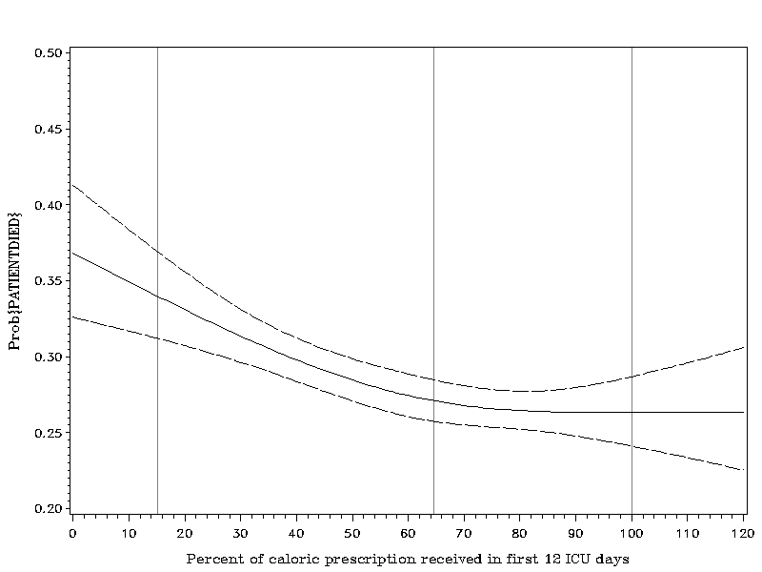
Optimal Amount of Calories for Critically Ill Patients: Depends on how you slice the cake!
Association Between 12-day Caloric Adequacy
and 60-day Hospital Mortality
Optimal amount =
80-85%
Heyland DK, et al. Crit Care Med. 2011;39(12):2619-26.

Slide 4
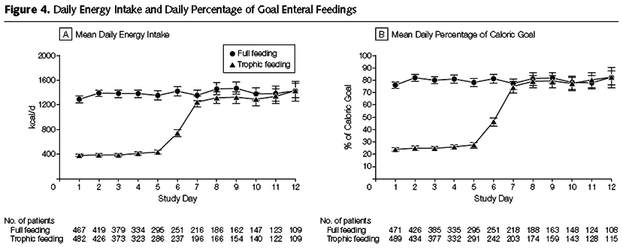
Initial Tropic vs. Full EN in Patients with Acute Lung Injury
The EDEN randomized trial
Rice TW, et al. JAMA. 2012;307(8):795-803.

Slide 5
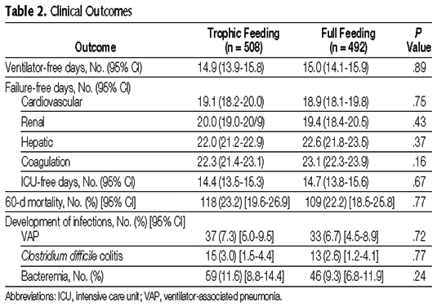
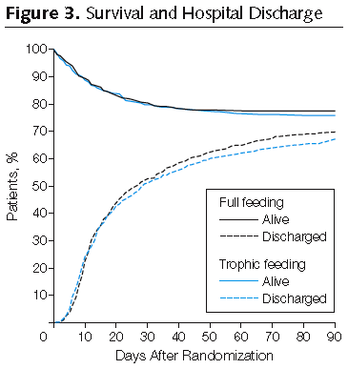
Initial Tropic vs. Full EN in Patients with Acute Lung Injury
The EDEN randomized trial
Rice TW, et al. JAMA. 2012;307(8):795-803.

Slide 6
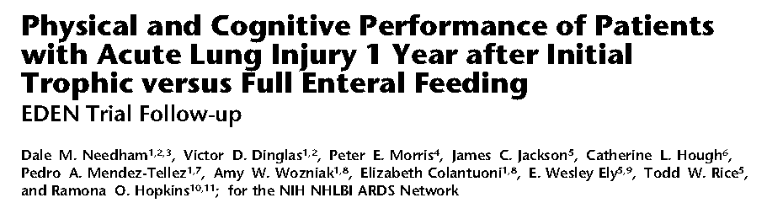
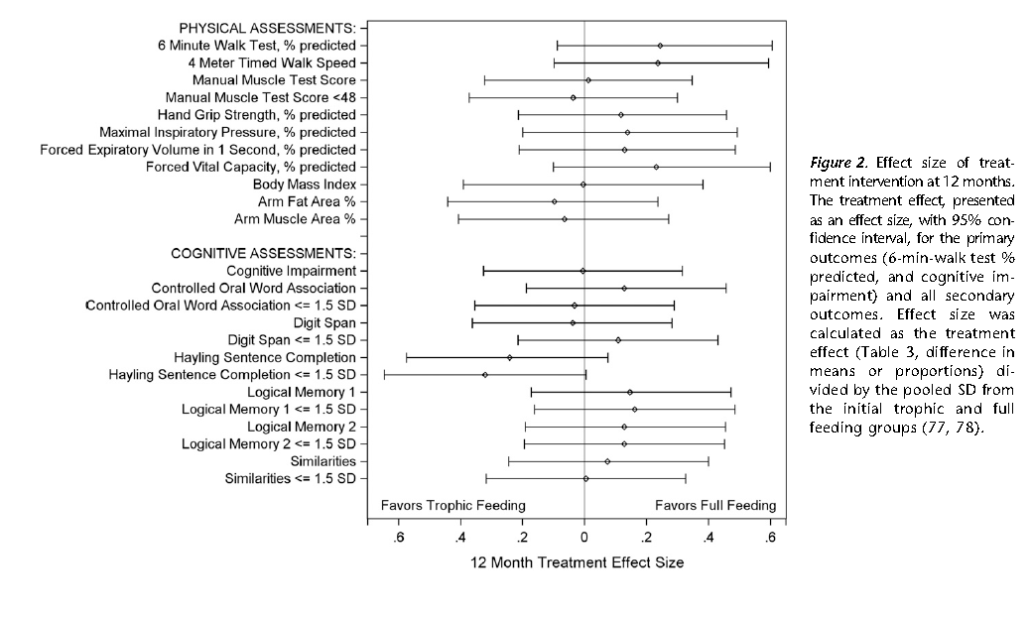

Slide 7
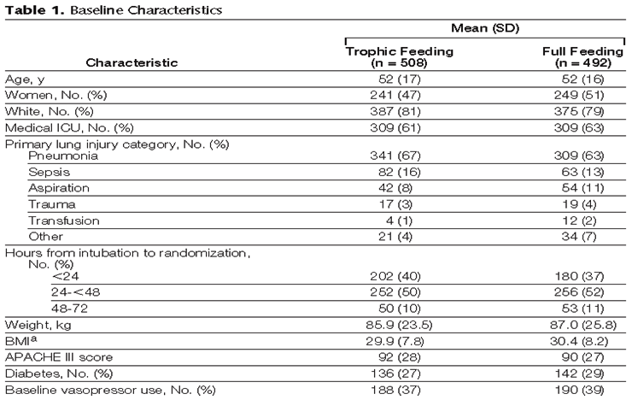
Initial Tropic vs. Full EN in Patients with Acute Lung Injury
The EDEN randomized trial
Enrolled 12% of patients screened
Rice TW, et al. JAMA. 2012;307(8):795-803.

Slide 8
Trophic vs. Full EN in Critically Ill Patients with Acute Respiratory Failure
Average age 52
Few comorbidities
Average BMI* 29-30
All fed within 24 hours (benefits of early EN)
Average duration of study intervention 5 days
No effect in young, healthy,
overweight patients who have short stays!
Heyland DK. Critical care nutrition support research: lessons learned from recent trials.
Curr Opin Clin Nutr Metab Care 2013;16:176-181.

Slide 9
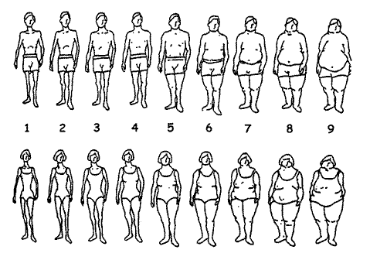
ICU Patients Are Not All Created Equal…
Should we expect the impact of nutrition therapy to be the same across all patients?

Slide 10
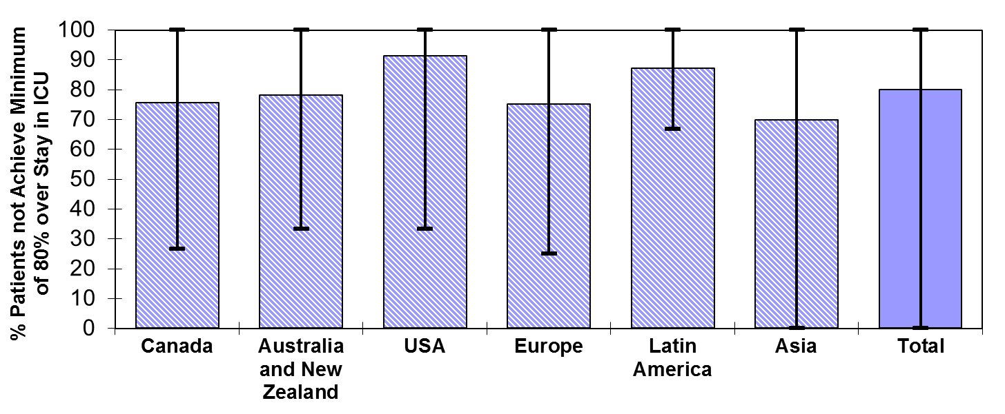
Failure Rate
% high risk patients who failed to meet minimal quality targets (80% overall energy adequacy)
91.2
87.0
75.6
78.1
75.1
79.9
69.8
Heyland 2013 (in submission)

Slide 11
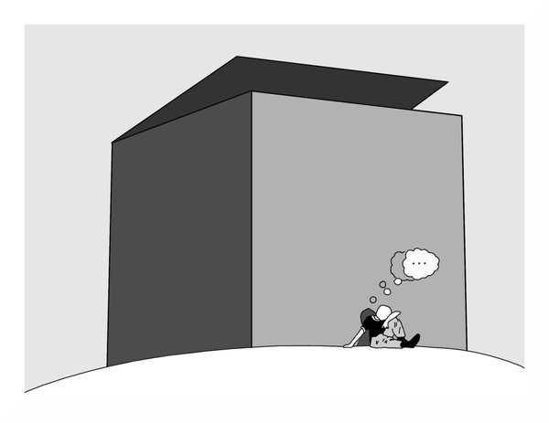
Can we do better?
The same thinking that got you into
this mess won’t get you out of it!

Slide 12

The Efficacy of Enhanced Protein-Energy Provision via the Enteral Route in Critically Ill Patients:
The PEP uP Protocol!
Different feeding options based on hemodynamic stability
and suitability for high volume intragastric feeds.
In select patients, we start the EN immediately at goal rate,
not at 25 ml/hr.
We target a 24 hour volume of EN rather than an hourly
rate and provide the nurse with the latitude to increase
the hourly rate to make up the 24 hour volume.
Start with a semi elemental solution, progress to polymeric.
Tolerate higher GRV* threshold (300 ml or more).
Motility agents and protein supplements are started
immediately, rather than started when there is a problem.
A major paradigm shift in how we feed enterally
* GRV: gastric residual volume
Heyland DK, et al. Crit Care. 2010;14(2):R78.

Slide 13
Change of Nutritional Intake from Baseline to Follow-up of All the Study Sites (All patients)
% Protein Received/Prescribed
p value=0.005
p value=0.81
Critical Care Medicine Aug 2013

Slide 14
Canadian PEP uP Collaborative
National Quality improvement collaborative in conjunction with Nestle
What we provide
All participating sites will receive:
access to an educational DVD presentation to train your multidisciplinary team
supporting tools such as visual aids and protocol templates
access to a member of the Critical Care Nutrition team who will support each site during the collaborative
access to an online discussion group around questions unique to PEP uP
a detailed site report, showing nutrition performance, following participation in the International Nutrition Survey 2013
online access to a novel nutrition monitoring tool we have developed
Tools, resources, contact information are available at criticalcarenutrition.com

Slide 15

Results of the Canadian PEP uP Collaborative
8 ICUs implemented PEP uP protocol through Fall of 2012-Spring 2013
Compared to 16 ICUs (concurrent control group)
All evaluated their nutrition performance in the context of INS 2013
Heyland JPEN 2014 (in press)

Slide 16
Results of the Canadian PEP uP Collaborative
 | PEP uP Sites (n=8) | Concurrent Controls (n=16) | P values*
Number of patients | 154 | 290
Proportion of prescribed calories from EN
Mean±SD | 60.1% ± 29.3% | 49.9% ± 28.9% | 0.02
Proportion of prescribed protein from EN
Mean±SD | 61.0% ± 29.7% | 49.7% ± 28.6% | 0.01
Proportion of prescribed calories from total nutrition
Mean±SD | 68.5% ± 32.8% | 56.2% ± 29.4% | 0.04
Proportion of prescribed protein from total nutrition
Mean±SD | 63.1% ± 28.9% | 51.7% ± 28.2% | 0.01

Slide 17
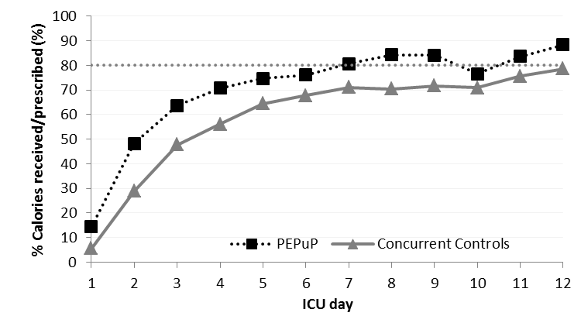
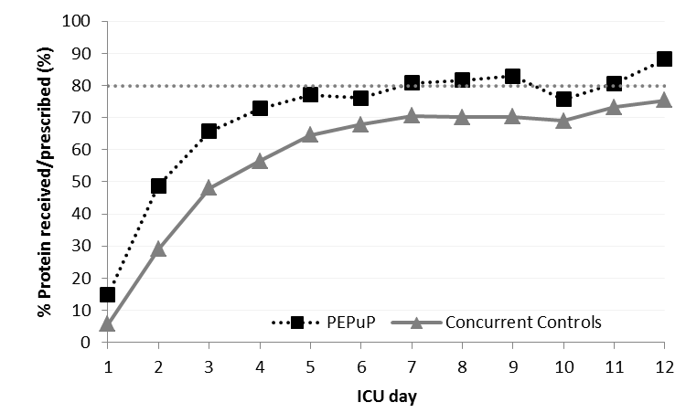
Results of the Canadian PEP uP Collaborative

Slide 18
Results of the Canadian PEP uP Collaborative
Average Caloric Adequacy Across Sites
Average Protein Adequacy Across Sites

Slide 19
Results of the Canadian PEP uP Collaborative
Proportion of Prescribed Energy From EN According to Initial EN Delivery Strategy
Just say no
to NPO*
Notes:
Need to update with new slide

Slide 20
Results of the Canadian PEP uP Collaborative
Proportion of Prescribed Protein From EN According to Initial EN Delivery Strategy
Just say no
to NPO*
Notes:
Need to update with new slides

Slide 21
Major Barriers to Protocol Implementation
Time consuming local approval process
Continuing education efforts for nursing staff
Changing the ICU culture
Concern regarding the use of motility agents
Concern regarding patients at risk of refeeding syndrome

Slide 22
Comments from Participating ICUs
Most of the staff like [the protocol]…but it is always a work in progress. If the pressure is let up, the protocol doesn't work. There is no one doing surveillance and hence the TF delivery is suboptimal. Pumps are not cleared at the appropriate time, rates not adjusted, etc.
The resources and support provided by the Critical Care Nutrition Team are absolutely amazing.
All the educational material/handouts/information has been very useful (and essential) in implementing this protocol in our unit
The NIBBLES articles have been fantastic in providing information to our unit and our MDs
Regarding the Red Cap software for the INS data collecton, it was very glitchy!

Slide 23
Conclusions
PEP uP protocol can be successfully implemented in real practice setting in Canada with no/limited additional resources provided

Slide 24
Next Steps
Initiate US PEP uP collaborative Spring 2014
Other countries interested?

Slide 25
Thank you for your attention.
Questions?

