Slide 1


Moving Towards Pragmatic Registry-Based Randomized Controlled Trials: It’s Worth the EFFORT!
Daren Heyland, MD
Charlene Compher, PhD
Todd Rice, MD
Nilesh Mehta, MD
Jayshil Patel, MD

Slide 2
CURRENT STATE OF CRITICAL CARE NUTRITION AND PROTEIN DOSE
What is the EFFORT trial?
Waiver of Consent

Slide 3

CURRENT STATE OF CRITICAL CARE NUTRITION AND PROTEIN DOSE

Slide 4
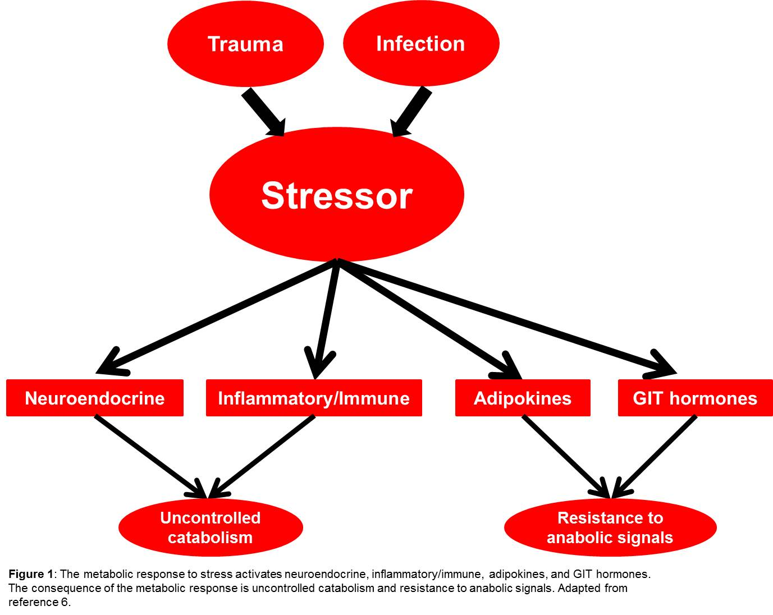
Protein and Critical Illness
Proteolysis
Patel JJ Crit Care Clin 2016;32:173-89.
Notes:
The sin qua non of critical illness is metabolic stress.
Sepsis, trauma, burns, etc., all activate the METABOLIC STRESS RESPONSE.
Neuroendocrine, inflammatory/immune, an adipokine response, and GIT hormone are components of the metabolic stress response.
These components lead to uncontrolled catabolism with PROTEOLYSIS and ANABOLIC RESISTANCE.
This leads to muscle breakdown, impaired muscle synthesis → IMPAIRED NITROGEN BALANCE!

Slide 5
Making Inferences from Scientific Research
Strong Clinical Recommendations!
None-weak inferences
Strong
Inferences!
LOTS OF BIAS
LITTLE BIAS
Randomized controlled trial
Systematic Reviews
Case Series
Case Control
Cohort Studies
Notes:
‘Ideally,’ we want a study from which we can derive STRONG INFERENCES. This is a RANDOMIZED CONTROLLED TRIAL, or the pinnacle of evidence.
We want this RANDOMIZED CONTROLLED TRIAL to inform us of an important outcome related to critically ill patients – such as MORTALITY!
What do we have?

Slide 6
Protein Dose and Outcomes
IDEAL
Protein dose and function / illness
Protein dose and mortality
-Rugeles et al. J Crit Care 2016 Oct;35:110-4.
-Ferrie et al. JPEN 2016;40:795-805.
Quality of Evidence
2016 ASPEN/SCCM guideline suggests 1.2-2.0 g/kg ABW/day
Protein dose and nitrogen balance
Protein dose and muscle mass
-Alberda et al. Int Care Med 2009;35:1728-1737.
-Kutsogiannis et al. Crit Care Med 2011;39:2691-2699.
-Allingstrup et al. Clin Nutr 2012;31:462-468.
-Weijs PJ et al. JPEN 2012;36:60-68.
-Weijs PJ et al. Crit Care 2014;18:701-714.
-Compher C et al. Crit Care 2017;45:156-163
-Larsson J et al. Br J Surg 1990;77:413-416.
-Iapichino G et al. ICM 1988:14:399-405.
-Berg et al. Crit Care 2013;17:R158.
-Ishibashi N et al. Crit Care Med 1998;26:1529-1535.
-Casaer et al. Crit Care Med 2013;41:2298-2309.
-Puthucheary et al. JAMA 2013;310:1591-1600.
Magnitude of Outcomes
Notes:
This graphic shows MAGNITUDE OF OUTCOME on the x-axis and QUALITY OF EVIDENCE on the y-axis.
PROTEIN DOSE has been associated with numerous OUTCOMES – including NITROGEN BALANCE, FUNCTION (e.g., hand grip), and MORTALITY. The mortality data is observational. Unfortunately, there are no RANDOMIZED CONTROLLED TRIALS evaluating the impact of protein dose on MORTALITY.
Therefore, guidelines, which summarize data and inform us of clinical practice, recommend a WIDE RANGE of protein dose recommendations.
Despite what the guidelines say – how much protein are patients ACTUALLY receiving?

Slide 7

International nutrition survey
-Prospective snapshot of clinical practice
-De-identified data about patients, nutrition practices, and outcomes
-Waiver of informed consent
Five Year Survey Participation:708 ICUs
Canada: 95
USA: 225
Europe and Africa: 109
UK: 37
Turkey: 11
Ireland: 12
Italy: 9
Norway: 8
South Africa: 13
Switzerland: 4
Spain: 4
Slovenia:1
Sweden: 3
Czech Republic:3
Austria:2
Portugal:1
France:1
Asia: 145
Colombia:19
Brazil:10
Argentina:7
Uruguay:5
Mexico: 3
Chile:3
Venezuela:2
Peru:1
Paraguay:1
El Salvador:1
Puerto Rico:1
China: 38
Japan: 43
India: 36
Taiwan:5
Singapore: 11
Saudi Arabia:2
Philippines:2
Iran : 2
Thailand: 2
UAE:1
Malaysia:2
Indonesia:1
Latin America: 53
Australia: 73 New Zealand: 8
Heyland DK et al. Nutr Clin Pract 2017.32:58S-71S
Notes:
In 2014, an International Nutrition Survey was conducted of ACTUAL clinical practice in 187 ICUs around the world, which included 4000 patients. Effectively the survey capture “a snapshot of clinical practice.”

Slide 8
How much protein is PRESCRIBED?
LOW RANGE
0.5 g/kg/day
AVERAGE
1.3 g/kg/day
HIGH RANGE
3.8 g/kg/day
LOW RANGE
0.86 g/kg/day
SITE MEDIAN
1.2 g/kg/day
HIGH RANGE
2.6 g/kg/day
Heyland DK et al. Nutr Clin Pract 2017.32:58S-71S
Notes:
On average, patients were prescribed 94 grams protein per day or ~1.3 g/kg/day. The overall range was 0.5-3.8 g/kg/day.
The MEDIAN PER SITE was 1.2 g/kg/d with a range of 0.86 to 2.6 g/kg/d.
Of these 187 sites, only 6% were achieving 80% of prescribed amounts and overall, ICU patients received 55% of prescribed protein.
Overall – protein delivery is LOW.
The next question is…do ALL patients benefit from GREATER PROTEIN DOSE?
The story begins to unfold a little more…
Do all ICU patients benefit from the same protein dose?

Slide 9
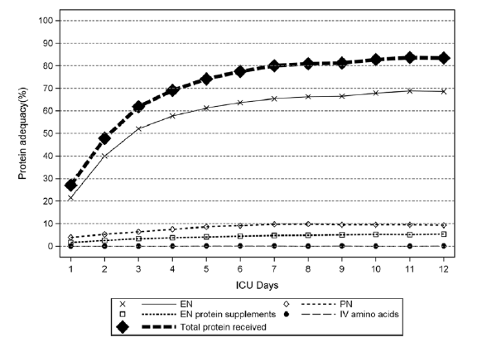
How much protein is ACTUALLY delivered?
LOW RANGE
15% PRESCRIBED
(0.2 g/kg/d)
AVERAGE
55% PRESCRIBED
(0.7 g/kg/d)
HIGH RANGE
101% PRESCRIBED
(1.31 g/kg/d)
Heyland DK et al. Nutr Clin Pract 2017.32:58S-71S
Notes:
On average, patients were prescribed 94 grams protein per day or ~1.3 g/kg/day. The overall range was 0.5-3.8 g/kg/day.
Of these 187 sites, only 6% were achieving 80% of prescribed amounts and overall, ICU patients received 55% of prescribed protein.
Overall – protein delivery is LOW.
The next question is…do ALL patients benefit from GREATER PROTEIN DOSE?
The story begins to unfold a little more…
Do all ICU patients benefit from the same protein dose?

Slide 10
At Best: Weak to Moderate Inferences!
Strong Clinical Recommendations!
Weak to moderate recommendations!
None-weak inferences
-Alberda Int Care Med 2009;35:1728-37.
-Kutsogiannis Crit Care Med 2011;39:2691-99.
-Allingstrup Clin Nutr 2012;31:462-68.
-Weijs JPEN 2012;36:60-68.
-Weijs Crit Care 2014;18:701-14.
-Nicolo JPEN 2016;40:45-51
-Compher Crit Care 2017;45:156-63
Strong
Inferences!
LOTS OF BIAS
LITTLE BIAS
Randomized controlled trial
Systematic Reviews
Case Series
Case Control
Cohort Studies
Notes:
Remember…we use data to make INFERENCES. These data are OBSERVATIONAL DATA.
Here’s the list of observational data. The bolded reference is the one I presented.
The data presented do not permit us to make STRONG INFERENCES and hence STRONG CLINICAL RECOMMENDATIONS. At best, we can make recommendation based on low to moderate quality evidence and hence draw WEAK TO MODERATE INFERENCES for WEAK TO MODERATE RECOMMENDATIONS!
In effect, we have a WIDE RANGE OF ACCEPTABILITY and LOW QUALITY OF EVIDENCE!

Slide 11
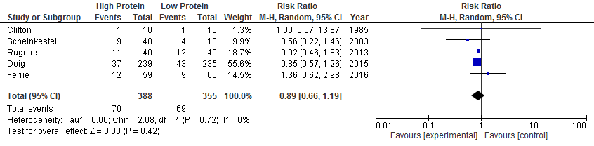
RCTs comparing High vs. Low Protein Dose in Critically ill Patients
Notes:
There are 5 RCTs comparing high versus low protein in critically ill patients.
These studies are small, have varying populations (such as renal failure), low methodologic quality, and report variable outcomes (such as hand grip strength in Ferrie study, change in SOFA score in Rugeles study). No study reported mortality as a primary outcome. Furthermore, the Forest plot shows confidence intervals crossing unity.

Slide 12
Summarizing The Current Paradigm…
Protein loss occurs in critically ill patients.
Protein supplementation is recommended for ICU patients.
Recommendations suggest 1.2 – 2.0 g/kg/day
Recommendations are from observational data
Therefore clinical practice has significant variation.

Slide 13
Clinical Equipoise
There is not one better intervention present. A true state of equipoise exists when one has no good basis for a choice between two or more care options.
Randomized controlled trial needed to resolve clinical equipoise!
Lauer MS. 2013 NEJM 369:1579-81
Notes:
Clinical equipoise exists for ICU protein supplementation. For guidelines to provide a stronger recommendation – an RCT is needed to resolve the equipoise.

Slide 14
What is the EFFORT trial?

Slide 15

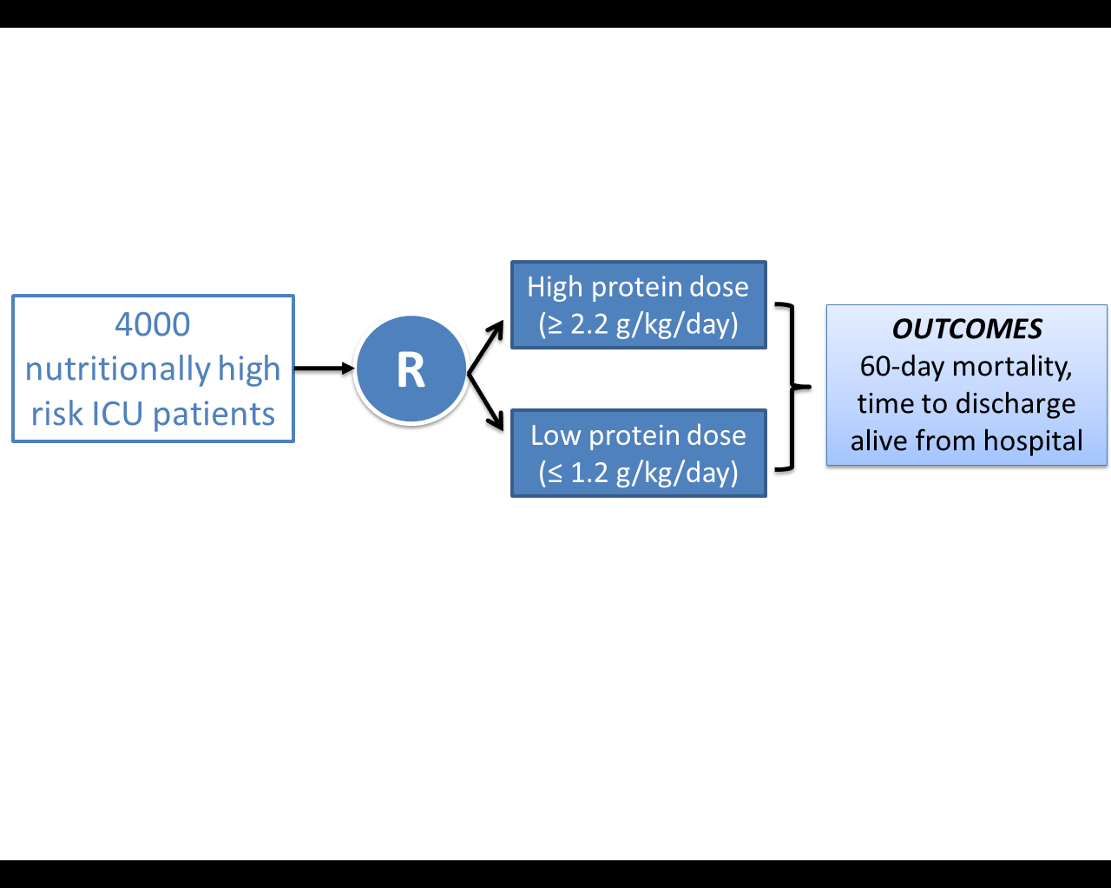
The Effect of Higher Protein Dosing in Critically ill Patients: EFFORT TRIAL
A multicenter, pragmatic, volunteer-driven, registry-based, randomized, clinical trial
Notes:
EFFORT is a multi-center pragmatic volunteer driven, registry based RCT aiming to randomize approximately 4000 patients to HIGH or LOWER end of protein.
The hypothesis is: Compared to the receiving lower dose of prescribed protein, the prescription of a higher dose of protein/amino acids to nutritionally high-risk critically ill patients will be associated with greater amount of protein delivered and result in improved survival and a quicker rate of recovery.

Slide 16
Randomized Controlled Trial Formats
RCT
Pragmatic Registry Based
Explanatory
Limited generalizability
Fail to show a ‘signal’ of benefit
Very costly
Time consuming
Randomize unproven intervention
Results more generalizable
Make causal inferences
Volunteer driven
Less time consuming
Randomize ‘standard of care’
Lauer MS. 2013 NEJM 369:1579-81
Notes:
What is a pragmatic registry trial?
In general, there are two types of trials.
Explanatory trials can take years to complete, often have limited generalizability, are very costly, time-consuming and randomize an UNPROVEN intervention against a placebo or existing standard of care.
Pragmatic registry based trials are best suited for open-label evaluations of commonly used alternatives (standards of care) where there is limited funding and end points are easily measured, objective. The data is collected by existing registries and supported by volunteers (essentially no cost). Most importantly, since two standards of care randomized, the results are more generalizable.

Slide 17

An Example of a Registry Based RCT
Randomized patients undergoing angioplasty to MANUAL ASPIRATION or USUAL CARE
Used existing Swedish cardiac registries
Over 7000 patients efficiently recruited to evaluate the study question
The trial IMPOSED NO OTHER STUDY PROCEDURES!
All data were collected by the existing registries
No patients lost to follow-up
Total COST → 300,000 Euros or 50 Euros per patient enrolled!
Frobert NEJM 2013 369:1587-97
Notes:
Here is an example of a pragmatic registry trial fro Sweden.

Slide 18
International Nutrition Survey Infrastructure
Canada: 95
USA: 225
Europe and Africa: 109
UK: 37
Turkey: 11
Ireland: 12
Italy: 9
Norway: 8
South Africa: 13
Switzerland: 4
Spain: 4
Slovenia:1
Sweden: 3
Czech Republic:3
Austria:2
Portugal:1
France:1
Asia: 145
Colombia:19
Brazil:10
Argentina:7
Uruguay:5
Mexico: 3
Chile:3
Venezuela:2
Peru:1
Paraguay:1
El Salvador:1
Puerto Rico:1
China: 38
Japan: 43
India: 36
Taiwan:5
Singapore: 11
Saudi Arabia:2
Philippines:2
Iran : 2
Thailand: 2
UAE:1
Malaysia:2
Indonesia:1
Latin America: 53
Australia: 73 New Zealand: 8
Heyland DK et al. Nutr Clin Pract 2017.32:58S-71S
Notes:
The idea behind EFFORT is to use the same volunteer driven INS infrastructure to support a large scale RCT to answer a clinical question.

Slide 19
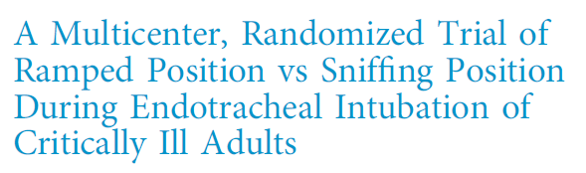

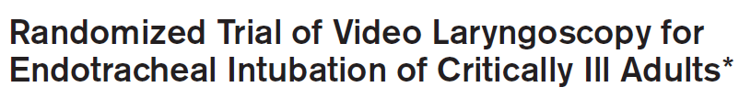

Clinical
Equipoise…
BOUNDARIES OF ICU STANDARDS OF CARE
Notes:
Besides the REGISTRY BASED nature of the RCT, many pragmatic studies also are comparing interventions that are within the bounds of standards of ICU care.
Here are some examples of recent trials published in high impact journals (CLICK)
EFFORT will simply replace the standard of care with a randomization scheme.

Slide 20
The Effect of Higher Protein Dosing in Critically ill Patients: EFFORT TRIAL
STANDARD OF CARE
REGISTRY BASED
A multicenter, pragmatic, volunteer-driven, registry-based, randomized, clinical trial
Notes:
And so…using a REGISTRY BASED INFRASTRUCTURE (CLICK), the EFFORT trial will randomize TWO STANDARDS OF CARE (CLICK)

Slide 21
Inclusion and Exclusion Criteria
Inclusion Criteria | Exclusion Criteria | Rationale for Exclusion
>18 years old 2. Nutritionally ‘high-risk’ 3. Requiring mechanical ventilation with actual or expected total duration of mechanical ventilation >48 hours | 1. >96 continuous hours of mechanical ventilation before screening | Intervention is likely most effective when delivered early
 | 2. Expected death or withdrawal of life-sustaining treatments within 7 days from screening | Patients unlikely to receive benefit
 | 3. Pregnant | Unknown effects on fetus
 | 4. The responsible clinician feels that the patient either needs low or high protein | Uncertainty doesn’t exist; patient safety issues
Notes:
Here are EFFORT’s inclusion and exclusion criteria – many of which are self-evident.

Slide 22
Waiver of Consent and Central IRB Status

Slide 23
What is required for a waiver of consent?
Three components:
1. Minimal risk (common rule)
2. Does not reduce ‘involuntariness’ of current practice
3. Research could not be practicably carried out without waiver
Asch DA. NEJM 2017;377:1412-13
Notes:
Since pragmatic registry based trials have been conducted under a waiver of consent – we need to understand the components required to obtain waiver of consent.
The three components are 1. minimal risk 2. the absence of waiver of consent does not reduce the involuntariness of current practice and 3. the research could not be practicably carried out without a waiver.
Let’s look at these individually.

Slide 24

1
Minimal Risk
…as risk in which "the probability and magnitude of harm or discomfort anticipated in the research are not greater in and of themselves than those ordinarily encountered in daily life or during the performance of routine physical or psychological examinations or tests"
Minimal Risk Applies to the research and its processes
Asch DA. NEJM 2017;377:1412-13
Notes:
The definition of minimal risk is as follows:
“…as risk in which "the probability and magnitude of harm or discomfort anticipated in the research are not greater in and of themselves than those ordinarily encountered in daily life or during the performance of routine physical or psychological examinations or tests“
Let’s look at the underlined components in more detail to identify why EFFORT is considered minimal risk.

Slide 25
1
Does EFFORT meet minimal risk?
Misconception: There is excessive distinction between research and quality improvement.
Evolution of modern medicine is such that clinical research is embedded into ‘learning health systems’, a system designed to improve the effectiveness and safety of health care by creating that ‘continuously learning to be better.’
To the extent that all activities aim to generate reusable knowledge, the distinction is not whether an activity is research but whether it risks harming people.
Is the research proposed in EFFORT minimal risk?
Notes:
There’s a misconception about the excessive distinction between research and quality improvement.
Regardless of the “activity,” the question is to ask here is whether the research in EFFORT will cause harm…

Slide 26
1
Does EFFORT meet minimal risk?
Clinical equipoise exists for protein dose in critically ill patients.
EFFORT is only randomizing protein doses (within the standard of care).
If clinical equipoise does not exist for an individual patient, the provider can choose to opt-out of the study.
No modifications to usual care will be used.
No experimental products will be used.
No tissue or blood specimens will be collected for the RCT.
Participating sites will not receive payment or incentives.
A unique patient ID number will be assigned and no direct patient identifiers will be disclosed to the registry site or in any publication or presentation
Notes:
Here are the reasons EFFORT is considered ‘minimal risk.’

Slide 27
1
Does EFFORT meet minimal risk?
9. Data collected for this study will mirror data collected for the INS, a multi-center, multi-national quality improvement collaborative, which has been granted a waiver of consent for more than a decade for >250 ICUs across the United States and >500 ICUs worldwide.
10. Data collected from standard hospital records and there are no study-specific procedures EXCEPT randomization of protein dose.
11. Simply adding a randomization function to these patients in which equipoise exists does not increase the risk and is consistent with ‘minimal risk.’
Other registry based and pragmatic trials have been granted waiver of informed consent.
Two US sites (Vanderbilt and University of Pennsylvania) granted ‘waiver of consent’ for EFFORT

Slide 28
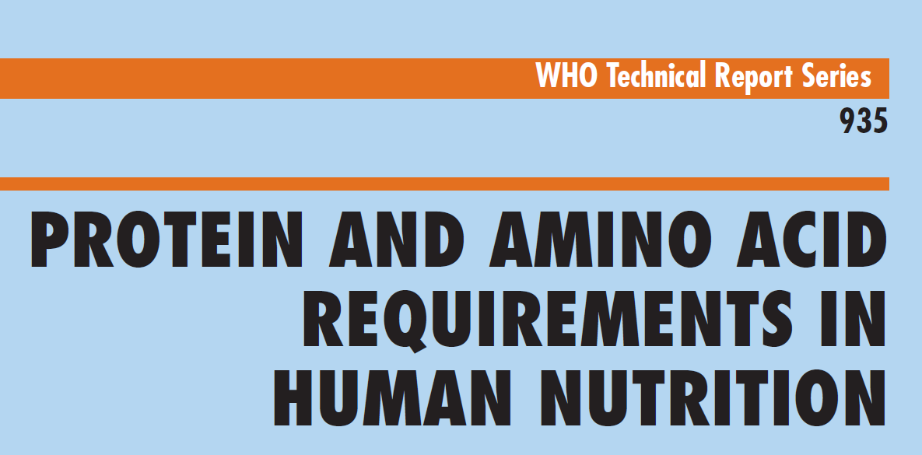
1
Does EFFORT meet minimal risk?
…encountered in daily life or during the performance of routine physical or psychological examinations or tests"
Recommended protein to maintain net neural nitrogen balance is 0.6 to 0.9 g/kg/d in healthy humans
People on a Western diet consume up to 4 g/kg/d (3 g/kg/day from food and 1 g/kg/day from supplements), totaling 320 g/day WITHOUT adverse consequences reported.
Notes:
Next, IRBs interpret ‘encountered in daily life’ differently.
One interpretation is daily life (outside of the ICU).
This being said, is there a maximum limit of dietary protein intake for healthy humans?
Data from the PROTEIN AND AMINO ACID REQUIREMENTS IN HUMAN NUTRITION BY THE WHO:
In developed countries most people consume substantially more protein than the safe level, especially through consumption of meat-based diets at energy intakes required to meet the demands of high levels of physical activity, or with supplementary protein intakes often consumed by young men attempting to increase their musculature. Typical intakes are up to 3.0 g/kg from food with an extra 1 g/kg from supplements. This is equivalent to 320 g/day for an 80-kg male.
Even in patients with renal insufficiency, intake of 230 g/day was not associated with any ill effects.
The EFFORT trial will test protein doses within the standards of ICU care, with the upper limit of 2.2 g/kg/d being significantly less than that observed in Western diets.

Slide 29
Does EFFORT reduce the involuntariness of current practice?
2
Misconception: A focus on protecting voluntariness for ‘standard of care’ trials
Currently, patients and their families are not consulted on their protein prescription → unlikely anyone would insist that patient A or B provide consent for protein doses X or Y.
Deploying standard of care randomization does not increase the involuntariness beyond what was already acceptable.
Asch DA. NEJM 2017;377:1412-13
Notes:
A second misconception is regarding waiver of consent trials reducing patient involuntariness…

Slide 30
Does EFFORT reduce the involuntariness of current practice?
2
Misconception: Equating the ease or courtesy of requesting consent with the need or appropriateness of doing so.
Success in achieving behaviors might come more easily to the people (in this case, clinicians) who are motivated to obtain consent to a trial.
Consent requirements can make low-risk trials LESS rather than more ethical if the bias they create undermines the trial’s value.
The test or practicability is not whether investigators can logically confront patients to request their consent, but whether they can do so while preserving the trial’s validity.
For a ‘real practice’ pragmatic study such as EFFORT → high risk of limiting generalizability if consent is required
Asch DA. NEJM 2017;377:1412-13
Notes:
Furthermore, equating the ease or courtesy of requesting consent with the ACTUAL NEED or appropriateness of doing so is a third misconception…

Slide 31
EFFORT could not be practicably carried out without a waiver.
3
Integrated consent is the ‘alternative’ to the ‘learning health model.’
Integrated consent model is not practicable in the mechanically ventilated critically ill patient, often sedated and unconscious → requires verbal conversations at the point of decision making.
  Impracticable because initiating protein is time-sensitive.
  Impracticable because protein dose (wide standard of care) is not discussed with patient or family.
  3. No funding is available for this registry based volunteer-driven trial.
  Impracticable because the trial will rely on motivated clinicians to obtain informed consent and can lead to a selection bias, severely limiting generalizability of the trial.
Asch DA. NEJM 2017;377:1412-13
Notes:
The last question to answer is whether obtaining consent would be practicable…
I’ve highlighted in an earlier slide, one school of thought on research being integrated into a learning model. Here I discuss the integrated consent model where patients and families have extensive verbal discussions regarding involvement in any research..
This integrated model does not apply (and is impracticable) in mechanically ventilated, often sedated and unconscious patients.

Slide 32
Summary for Waiver of Consent
Minimal risk applies to the research and its processes.
An optimal protein dose in critically ill patients has not been established.
Widespread standard of care, in general, ought to depend on a strong evidentiary base.
Therefore, multiple standards of care exist for protein dose in critically ill patients.
The EFFORT trial aims to randomize protein dose within the standard of care.
The interventions are within the boundaries of standard of care.
The research mirrors standard of care and is therefore associated with minimal risk.
Deploying a ‘randomization’ scheme does not reduce involuntariness.
The impracticability of utilizing an integrated consent model in the ICU, the time-sensitive nature of protein administration, and lack of funding makes EFFORT impractical without a waiver of consent.

Slide 33

The Effect of Higher Protein Dosing in Critically Ill Patients: A Multicenter Registry-based Randomized Trial The EFFORT Trial
Steering Committee
Daren Heyland, MD
Charlene Compher, PhD
Todd Rice, MD
Nilesh Mehta, MD
Jayshil Patel, MD
Principal Investigator
Dr. Daren Heyland
Queen’s University
Kingston General Hospital
Clinical Evaluation Research Unit
Watkins 5C, Room 4-5-308-0
76 Stuart Street
Kingston, ON K7L 2V7
Email: dkh2@queensu.ca
Clinical trials.gov ID #NCT03160547
https://www.criticalcarenutrition.com/ins/effort

