Slide 1
Protein in Critical illness
Evidence and Current Practices
Rupinder Dhaliwal, RD
Manager, Research & Networking
Clinical Evaluation Research Unit
Queens University, Kingston ON

Slide 2
Learning Objectives
You will become familiar with the
  Latest evidence behind optimizing nutrition and protein intake in critical illness
  Current protein intakes in ICU patients: results of the International Nutrition Survey 2013
  Recent efforts at improving the delivery of protein in ICUs
    The PEP UP Protocol
    use of supplemental parenteral nutrition in high risk patients

Slide 3
Review of Evidence

Slide 4
Guidelines: SCCM/ASPEN 2009
Protein | Energy
assess adequacy protein provision regularly BMI <30: 1.2-2.0 g/kg actual body wt/d Higher in burn/ multi-trauma (Grade: E) | provide >50%-65% of goal calories over the first week of hospitalization (Grade: C)
Add refs or papers

Slide 5
Guidelines: ESPEN 2009
Protein | Energy
PN 1.3–1.5 g/kg ideal body weight plus adequate energy | EN acute and initial phase: avoid excess of 20–25 kcal/kg BW/day During recovery: 25–30 total kcal/kg BW/day (C))
 | PN acute illness: meet measured energy expenditure in order to decrease negative energy balance (Grade B). If no indirect calorimetry: 25 kcal/kg/day increasing to target over the next 2–3 days (Grade C).
Add refs or papers

Slide 6
Guidelines: Canadian 2013
Protein | Energy
There are insufficient data to make a recommendation regarding the use of high protein diets for head injured patients and other critically ill patients | EN when starting enteral nutrition in critically ill patients, strategies to optimize delivery of nutrients (starting at target rate, higher threshold of gastric residual volumes, use of prokinetics and small bowel feedings) should be considered. There are insufficient data to make a recommendation on the use of indirect calorimetry vs. predictive equations for determining energy needs for nutrition or to guide when nutrition is to be supplemented in critically ill patients. There are insufficient data to make a recommendation on the use of hypocaloric enteral nutrition in critically ill patients.
 | PN Based on 4 level 2 studies, in critically ill patients who are not malnourished, are tolerating some EN, or when parenteral nutrition is indicated for short term use (< 10 days), low dose parenteral nutrition should be considered. There are insufficient data to make recommendations about the use of low dose parenteral nutrition in the following patients: those requiring PN for long term (> 10 days); obese critically ill patients and malnourished critically ill patients. Practitioners will have to weigh the safety and benefits of low dose PN on an individual case-by-case basis in these latter patient populations.

Slide 7
Conflicting evidence
Surviving Sepsis Campaign Guidelines CCM Feb 2013
Topic | Key points of SSC guidelines on EN | Key points of Canadian guidelines on EN
Early vs. Delayed Nutrient Intake | Administer oral or enteral (if necessary) feedings, as tolerated, rather than either complete fasting or provision of only intravenous glucose within the first 48 hours after a diagnosis of severe sepsis/septic shock (grade 2C). | Early EN (within 24-48 hours following admission to ICU) is recommended in critically ill patients. When starting EN in critically ill patients, strategies to optimize delivery of nutrients (starting at target rate, higher threshold of gastric residual volumes, use of prokinetics and small bowel feedings) should be considered.
Trophic vs. Full Feeds | Avoid mandatory full caloric feeding in the first week but rather suggest low dose feeding (e.g., up to 500 calories per day), advancing only as tolerated (grade 2B). | In patients with Acute Lung Injury, an initial strategy of trophic feeds for 5 days should not be considered.

Slide 8
Conflicting evidence
  EDEN study results
  Rice results
  Arabi
  Conclude that need to focus on “high risk patients”..Charlene to discuss this in detail

Slide 9
Recent review on protein
Hoffer et al
  Meta-analysis of 13 RCTs
  Show results
  Conclusions: 2.5 g/kg/day is safe and effective

Slide 10
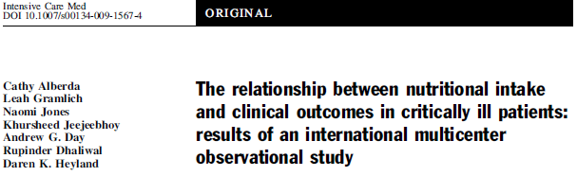
Point prevalence survey of nutrition practices in ICU’s around the world conducted Jan. 27, 2007
Enrolled 2772 patients from 158 ICU’s over 5 continents
Included ventilated adult patients who remained in ICU >72 hours

Slide 11
25%
50%
75%
100%

Slide 12
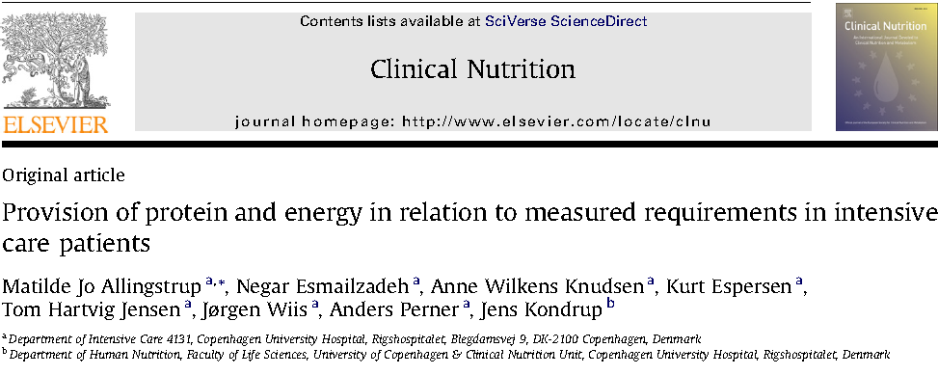
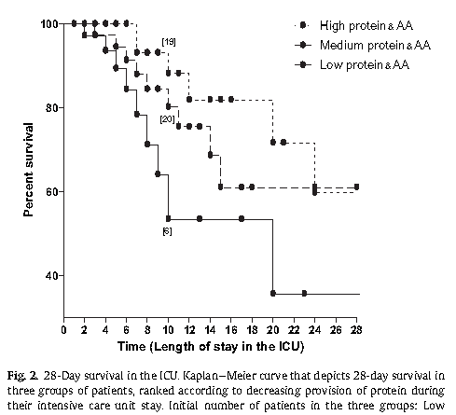
113 select ICU patients with sepsis or burns
On average, receiving 1900 kcal/day and 84 grams of protein
No significant relationship with energy intake but……
Clinical Nutrition 2012

Slide 13
Observational studies: protein results in better outcomes
Elke Critical Care 2013:
Only briefly mention this but Charlene to talk about results in more detail?

Slide 14
Current Practices
INS 2013

Slide 15

International Nutrition Survey (INS) 2013
Purpose
  illuminate gaps between current practice & guidelines
  identify practice areas to target for change
History
  started in Canada in 2001
  5th International audit (2007, 2008, 2009, 2011 & 2013)
Methods
  Observational, point prevalence study

Slide 16

Methods
Each ICU enrolled 20 consecutive patients
    ICU LOS> 72 hrs
    vented within first 48 hrs
Data abstracted from chart
  Hospital and ICU characteristics
  Patient information
  Baseline Nutrition Assessment
  Daily Nutrition data
  Patient outcomes
  (e.g. mortality, length of stay)
Benchmarking Report provided
Best of the Best Competition if n ≥ 20 patients

Slide 17
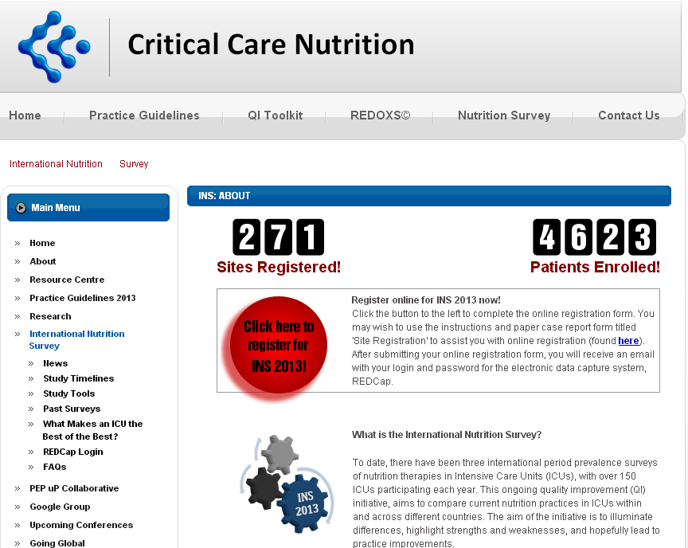
www.criticalcarenutrition.com
Notes:
Was the best year ever eh!!

Slide 18

Participation: INS 2013
202 ICUs
26 nations
4040 patients
37,872 days
Canada: 24
USA: 52
Europe & Africa: 35
Asia: 41
Japan: 21
India: 9
Singapore: 5
Philippines:2
China: 2
Iran : 1
Thailand: 1
Turkey: 11
UK: 8
Ireland: 4
Norway: 4
Switzerland: 3
Italy: 1
Sweden: 1
Spain: 1
South Africa: 2
Colombia:6
Uruguay:4
Venezuela:2
Peru:1
Mexico: 1
Latin America: 14
Australia & New Zealand: 36
Notes:
18

Slide 19
ICU Characteristics
Characteristics | Total (n =202)
Hospital Type
Teaching | 170 (84.2%)
Non-teaching | 32( 15.8%)
Size of Hospital (beds)
Mean (Range) | 581 (50-2500)
ICU Structure
Open | 51 (25.2%)
Closed | 148 (73.3%)
Other | 3 (1.5%)
Size of ICU (beds)
Mean (Range) | 17(4-86)
Designated Medical Director | 185 (91.6%)
Presence of Dietitian(s) | 164 (81.2%)

Slide 20
Patient Characteristics
Characteristics | n = 4040
Age (years) Median [Q1,Q3] | 63 [50-74]
BMI Median [Q1, Q3] | 25.7 [22.5 - 30]
Admission Category Medical | 2588 (64%)
Surgical: Elective | 428 (10.6%)
Surgical: Emergency | 1024 (25.3%)
Apache II Score Median [Q1, Q3] | 22 [16-27]
Presence of ARDS | 365/4040 (9%)

Slide 21
Clinical Outcomes
Outcomes | n=4040
Length of Mechanical Ventilation (days)
Median [Q1, Q3] | 6.6 [3.1, 13.6]
Length of ICU Stay (days)
Median [Q1, Q3] | 10 [5.8, 18.9]
Length of Hospital Stay (days)
Median [Q1,Q3] | 21 [10.8, 44.9.]
Patient Died (within 60 days)
Yes | 991 (24.5%)

Slide 22
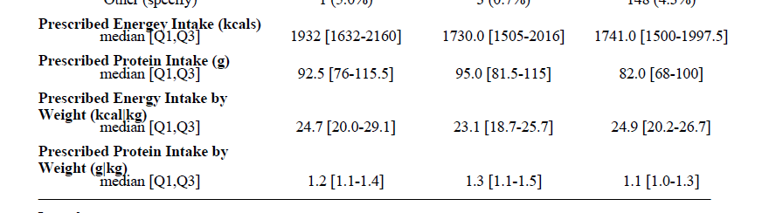

Slide 23
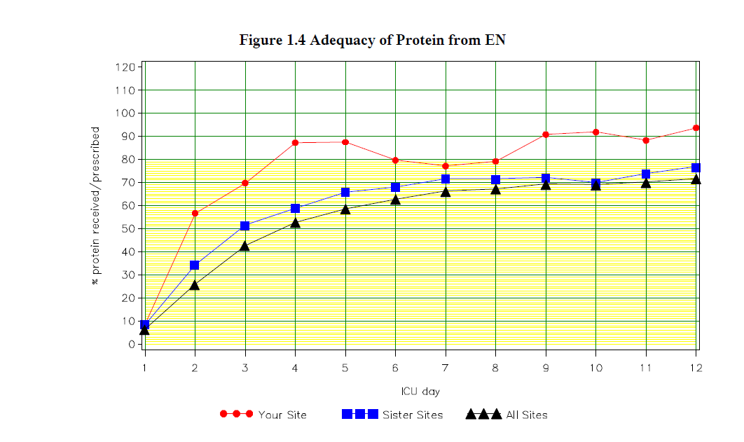
INS 2013

Slide 24
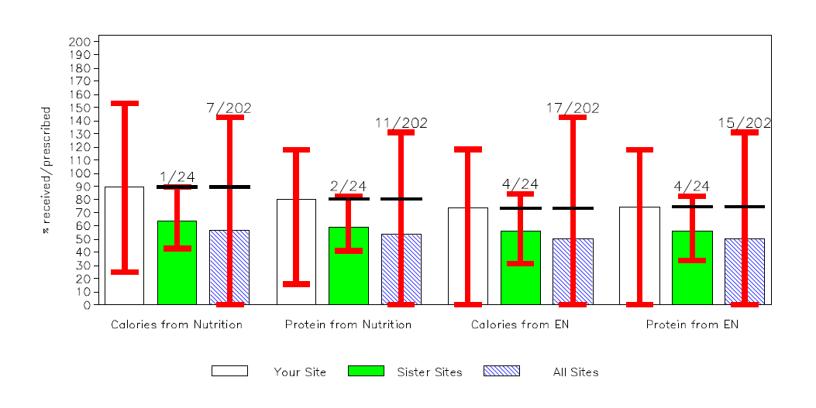

Slide 25
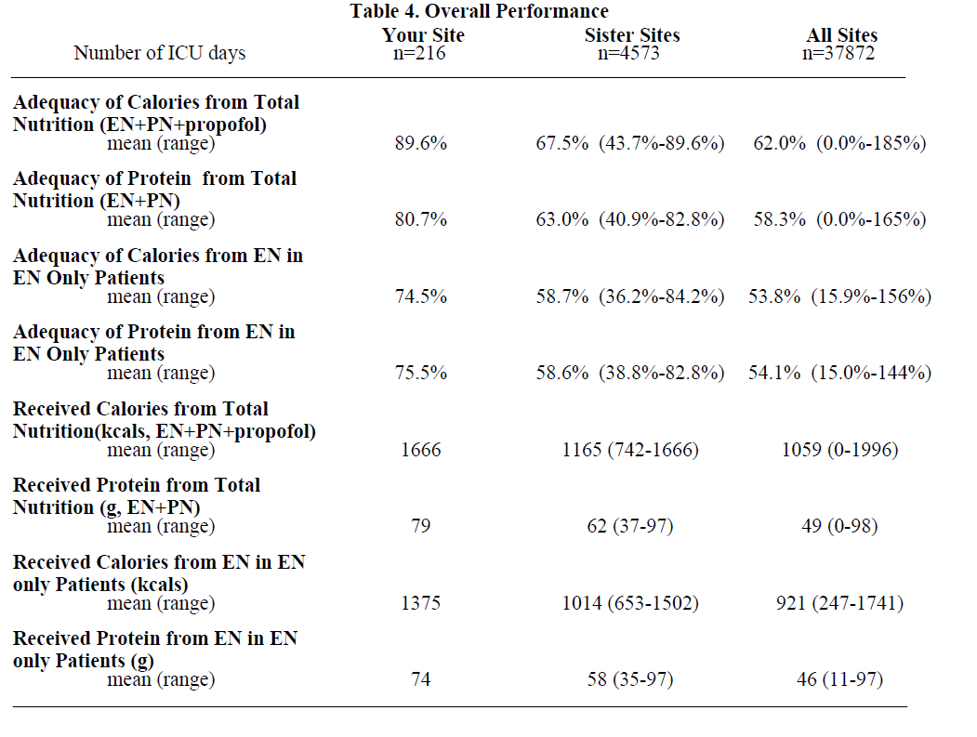

Slide 26
Barriers: innovative approaches to overcome these

Slide 27
Barriers to optimal protein intake
Unstable patients: Other aspects of care take precedence
No feeding tube in place
RD not around
Delays in MDs starting EN
M. agents not started when intolerance
MDs want pts to be NPO

Slide 28
The Efficacy of Enhanced Protein-Energy Provision via the Enteral Route in Critically Ill Patients:
The PEP uP Protocol!
A major paradigm shift in how we feed enterally
Different feeding options
  stable: start intragastric EN immediately at goal rate
  unstable: start at trophic feeds, 10 mls/hr and re-assess
  NPO: re-assess daily, ask for reason
Volume based feeding: target a 24 hour volume vs. hourly
RN driven: adjust hourly rate to make up the 24 hour volume
Semi elemental solution: start and progress to polymeric
Motility agents & protein supplements: immediately vs. after problem starts
Gastric Residual Volumes: higher threshold (300 ml or more).
Heyland DK, et al. Crit Care. 2010;14(2):R78.

Slide 29
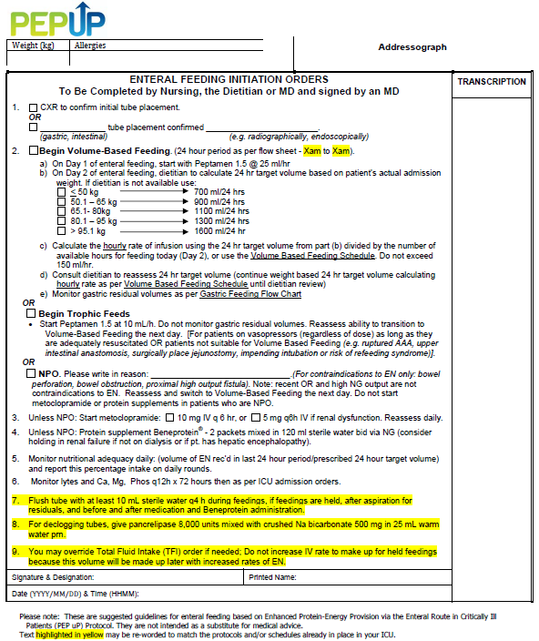

Slide 30
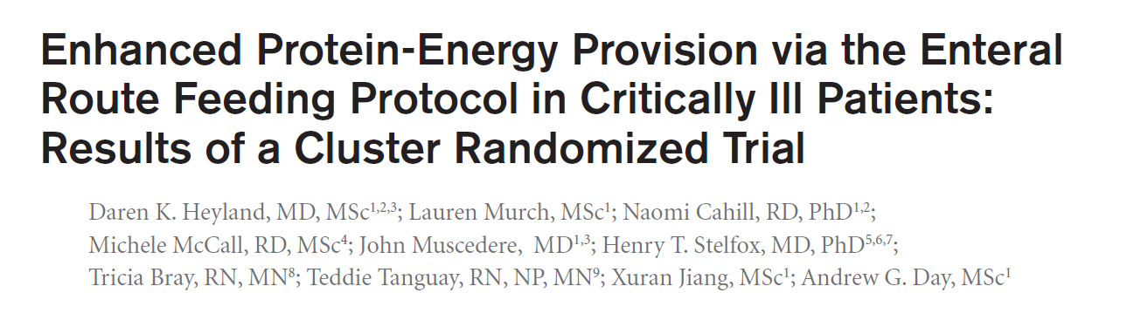
A multi-center cluster randomized trial
Critical Care Medicine Aug 2013

Slide 31

Research Questions
Primary: What is the effect of the new innovative feeding protocol, the PEP uP protocol, combined with a nursing educational intervention on
EN intake compared to usual care?
Secondary: What is the safety, feasibility and acceptability of
the new PEP uP protocol?
Hypothesis : this feeding protocol combined with a nurse-directed nutrition educational intervention will be safe, acceptable, and effectively increase protein and energy delivery to critically ill patients

Slide 32
Design
Control
18 sites
6-9 months later
Baseline
Follow-up
Intervention
Protocol utilized in all patient mechanically intubated within
the first 6 hours after ICU admission
Focus on those who remained mechanically ventilated > 72 hours
Notes:
IT IS OK, I VERBALIZE IT CORRECTLY

Slide 33
Change of Nutritional Intake from Baseline to Follow-up of All the Study Sites (All patients)
% Calories Received/Prescribed
p value=0.001
p value=0.71

Slide 34
Change of Nutritional Intake from Baseline to Follow-up of All the Study Sites (All patients)
% Protein Received/Prescribed
p value=0.005
p value=0.81

Slide 35
Complications
(All patients – n = 1,059)
Percent
Vomiting
Regurgitation
Macro Aspiration
Pneumonia
p > 0.05

Slide 36

Canadian PEP uP Collaborative
What we provided
access to an educational DVD presentation to train the multidisciplinary team
supporting tools such as visual aids and protocol templates (website)
access to a member of the Critical Care Nutrition team for support
access to an online discussion group around questions unique to PEP uP
a detailed site report, showing nutrition performance in INS Survey 2013
online access to a novel nutrition monitoring tool
National Quality improvement collaborative in conjunction with Nestle Health Science

Slide 37

Results of the Canadian PEP uP Collaborative
Fall of 2012-Spring 2013
8 ICUs implemented PEP uP protocol
Compared to 16 ICUs (concurrent control group)
All evaluated their nutrition performance (INS 2013)
Heyland JPEN 2014 (in press)

Slide 38
Results of the Canadian PEP uP Collaborative
 | PEP uP Sites (n=8) | Concurrent Controls (n=16) | P values*
Number of patients | 154 | 290
Proportion of prescribed calories from EN Mean±SD | 60.1% ± 29.3% | 49.9% ± 28.9% | 0.02
Proportion of prescribed protein from EN Mean±SD | 61.0% ± 29.7% | 49.7% ± 28.6% | 0.01
Proportion of prescribed calories from total nutrition Mean±SD | 68.5% ± 32.8% | 56.2% ± 29.4% | 0.04
Proportion of prescribed protein from total nutrition Mean±SD | 63.1% ± 28.9% | 51.7% ± 28.2% | 0.01

Slide 39
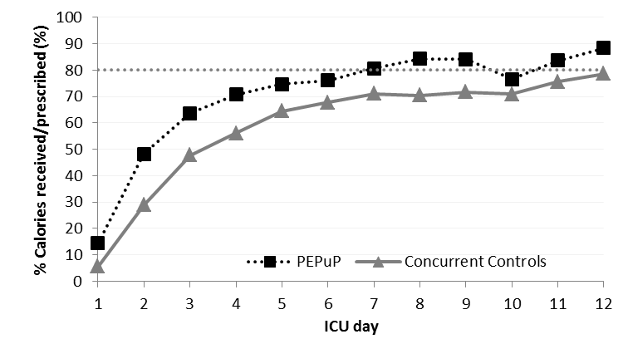
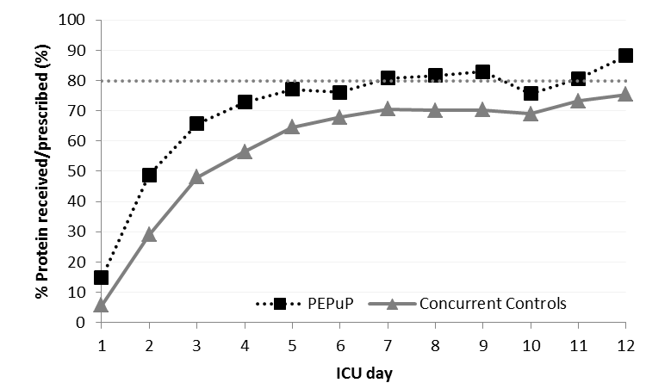
Results of the Canadian PEP uP Collaborative

Slide 40
Results of the Canadian PEP uP Collaborative
Average Caloric Adequacy Across Sites
Average Protein Adequacy Across Sites
p = 0.02
p = 0.004

Slide 41
Results of the Canadian PEP uP Collaborative
Proportion of Prescribed Protein From EN According to Initial EN Delivery Strategy
Just say no
to NPO*
Notes:
Need to update with new slides

Slide 42
Results of the Canadian PEP uP Collaborative
Patients in PEP uP Sites were much more likely to*:
  receive protein supplements (72% vs. 48%)
  receive 80 % of protein requirements by day 3 (46% vs. 29%)
  receive Semi- or elemental solution within first 2 days of admission
  (45% vs. 7%)
  receive a motility agent within first 2 days of admission (55% vs10%)
No difference in glycemic control
*All comparisons are statistically significant p<0.05

Slide 43


Next Steps
US PEP uP Collaborative
Started April 2014
9 sites as either Tier 1 or Tier 2
Using higher protein semi elemental formula
Supported by Nestle Health Science US
Latin American PEP uP Collaborative
Starting soon!
Aimed at Spanish speaking ICUs
Translation and Implementation: to be led by
Willy Manzanares, MD, Uruguay

Slide 44
When limited via EN route?
Use of supplemental PN
TOP UP Trial in BMI ≥35 and <25

Slide 45
Summary

