Slide 1
Enteral Nutrition Therapy for the Surgical Patient
Dietitians of Canada
Annual National Conference
John W. Drover, MD, FACS, FRCSC
Associate Professor
Department of Surgery
Queen’s University
June 18, 2011

Slide 2
Disclosures
Nestle Nutrition – honorarium
Covidien - honorarium
Baxter - honorarium
Abbott - honorarium
Cook – honorarium
I am a surgeon!

Slide 3
Case #1
48 yo female with sigmoid cancer
Sigmoid resection
Healthy, uneventful OR
When will this patient be fed?
What will the first diet be?

Slide 4
Case #2
69 year old male, perforated DU
COPD on home oxygen
Post-operatively to ICU
No other organ failure
Predicted slow wean
When do you start enteral nutrition?
    Day?
Will this patient have a SB feeding tube?
There are no bowel sounds audible – does that affect decision?

Slide 5
Case #3
66yo male with obstructing colon cancer
POD #4 develops sepsis
return to OR, anastamotic leak
  end ileostomy
Unstable in the OR
Post-op unstable transferred to our ICU
  difficult to oxygenate and ventilate - ARDS
  hypotensive on multiple vasopressors
    Vasopressin 0.04u/h
    Noradrenaline 12ug/min
    Dobutamine 5ug/kg/min
When do you start feeds?
What do you do with the Gastric Residual Volumes (GRV)?

Slide 6
Objectives
At the end of the session you will be able to:
Identify 3 areas for improvement in the nutrition of surgical patients
Identify 2 areas that can be targeted for improving nutrition delivery.
List two strategies to improve provision of nutrition for the surgical patient.

Slide 7
Which surgical patients?
Not ambulatory
Not short stay (eg. Acute colecystitis)
Significant surgical insult
GI/ortho/cardiac/thoracic/urology/gynecologic
Hospital stay >3 days +/- ICU

Slide 8
Myths of surgical patients
They are more sick
They are more complicated
They are older
They have an ileus
They are more likely to aspirate

Slide 9
Truths about surgeons
Genetic or acquired cognitive pattern
  Seldom wrong, never in doubt!
Innovators
  In technical realm
Long memories
  For their own complications

Slide 10
Physician Delivered Malnutrition
Prospective observational study
Principally surgical/trauma patients (74%)
Nutrition Therapy Team visited all patients
  Clear fluids/NPO for > 3 days
  Made suggestions in writing for team
  Appropriateness defined a priori
  Returned for follow-up
Franklin et al, (JPEN 2011)

Slide 11
Physician Delivered Malnutrition
Reasons for NPO/CLD Orders
Diet Order (n=days) | Unclear | Appropriate | Inappropriate
NPO N=1109 | 15.0% | 58.6% | 26.4%
CLD N=238 | 32.1%* | 25.6%* | 44.3%

Slide 12
Physician Delivered Malnutrition
Percent Compliance with MNT Dietitian Recommendations
1st Note
3.4 Days
2nd Note 6.1 Days
3rd Note
9.1 Days

Slide 13
Physician Delivered Malnutrition
Conclusions
Despite active MNT: CLD/NPO >3d common
Over 1/3 NPO and 2/3 CLD
  Inappropriate
  Poorly justified
Improving nutrition adequacy hampered by poor compliance with MNT suggestions

Slide 14
International Nutrition Survey
Drover et al, JPEN 2010
Nutrition Therapy for the Critically Ill Surgical Patient: We need to do Better.
Medical vs. Surgical
Point prevalence survey (2007, 2008)
269 ICUs world wide
5497 mechanically ventilated patients
ICU stay >3 days
12 days of data from date of admission
37.7% surgical admission diagnoses

Slide 15
Regions
Canada | 57 (21.2%)
Australia and New Zealand | 35 (13.0%)
USA | 77 (28.6%)
Europe and SA | 46 (17.1%)
China | 26 (9.7%)
Asia | 14 (5.2%)
Latin America | 14 (5.2%)

Slide 16
Structures of ICU
Teaching 79.2%
Hospital size 647.8 (108-4000)
Closed ICU 72.5%
Medical Director 92.9%
ICU size 17.6 (4-75)
Feeding protocol 77.3%
Presence of dietitian 79.6%
Glycemic protocol 86.3%

Slide 17
Patient Characteristics
 | Medical (n=3425) | Surgical (n=2072)
Age (years) | 60.1 (13-99) | 58.4 (12-94)
Male | 59.0% | 63.9%
Admission diagnosis
Cardiovascular/ Vasc | 498 (14.5%) | 417 (20.1%)
Respiratory | 1331 (38.9%) | 130 (6.3%)
Gastrointestinal | 155 (4.5%) | 636 (30.7%)
Neurologic | 392 (11.5%) | 285 (13.8%)
Trauma | 172 (5.0%) | 389 (18.8%)
Pancreatitis | 61 (1.8%) | 32 (1.5%)
APACHE II | 23.1 (1-54) | 21.0 (1-72)

Slide 18
Patient Outcomes
 | Medical | Surgical | p-value
Length of MV | 9.2 [4.4-20.5] | 7.4 [3.4-16.3] | <0.0001
Hospital LOS | 27.7 [14.7-60.0‡] | 28.2 [16.5-56.1] | 0.7859
ICU LOS | 12.4 [7.1-24.7] | 11.2 [6.7-21.2] | 0.0004
Mortality | 33.1% | 21.3% | <0.0001

Slide 19
Nutrition Outcomes
 | Medical | Surgical | p-value
Adequacy of approp calories | 56.1%±29.7% | 45.8%±31.9% | <0.0001
Type of Nutrition
EN only | 77.8% | 54.6%
PN only | 4.4% | 13.9%
EN + PN | 13.9% | 23.8%
None | 3.9% | 7.8%
Adequacy of EN | 49.6%±30.2% | 33.4%±29.5% | <0.0001
Time to start EN | 36.8±38.7 | 57.8±52.1 | <0.0001

Slide 20
Surgical subgroups
Gastrointestinal, Cardiac, Other
Patients undergoing GI and Cardiac
  More likely to use PN
  Less likely to use EN
  Started EN later
  Had total lower nutritional aedquacy
Improved Nutritional Adequacy
  Presence of feeding and/or glycemic protocols

Slide 21
Summary Medical vs. Surgical
Later initiation of EN
Decreased adequacy of nutrition (EN and PN)
GI and cardiac patients at highest risk of iatrogenic malnutrition
Improve nutrition delivery
  Functioning protocols (feeding or glycemic)

Slide 22
Perfectis
Barriers to feeding critically ill patients
Cross sectional survey of 7 ICUs in 5 hospitals
Randomly selected nurses interviewed
Teaching and non-teaching units
75% worked ICU full time
Half were junior nurses and a third were senior.
Cahill N et al, CNS 2011 abstract

Slide 23
Perfectis
Cahill N et al, CNS 2011 abstract

Slide 24
Perfectis
Cahill N et al, CNS 2011 abstract

Slide 25
What are the Potential Benefits of EN?
Maintenance of GI mucosal integrity
Gut motility
Improved gut immunity
Decreased complications
Improved wound healing
Decreased LOS

Slide 26
Parenteral Nutrition
Heyland, Drover et al, CJS, 2001
Meta-analysis, PN vs. Standard Care
27 RCT’s
No effect on mortality
  RR=0.97, 0.76-1.24
Complications trend to reduced
  RR=.081, 0.65-1.01
Subgroups
  Malnourished and pre-operative better
Caution
  Studies with lower method scores, before 1988

Slide 27
Early enteral vs. “nil by mouth”
Lewis et al, BMJ: 2001
Meta-analysis: early < 24 hours
11 RCTs, 837 patients
5 oral, 6 with tubes
8 LGI, 4 UGI, 2 HB
Reduced infection
  RR=0.72, .054-0.98, p=.036
Reduced HLOS
  0.84 days, p=0.001

Slide 28
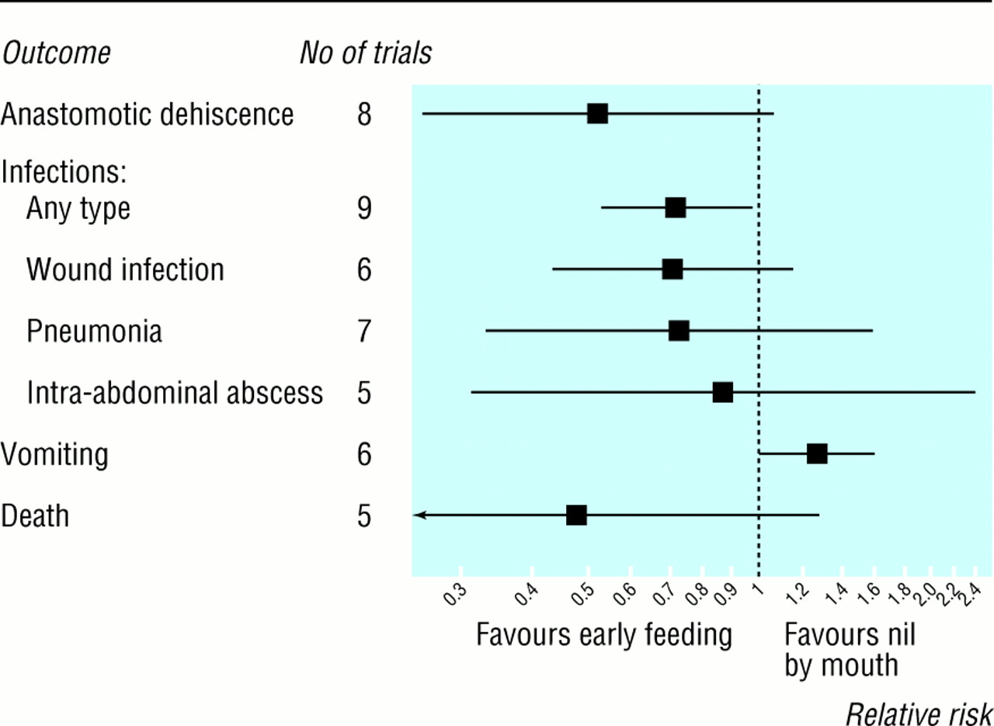
Lewis et al, BMJ: 2001

Slide 29
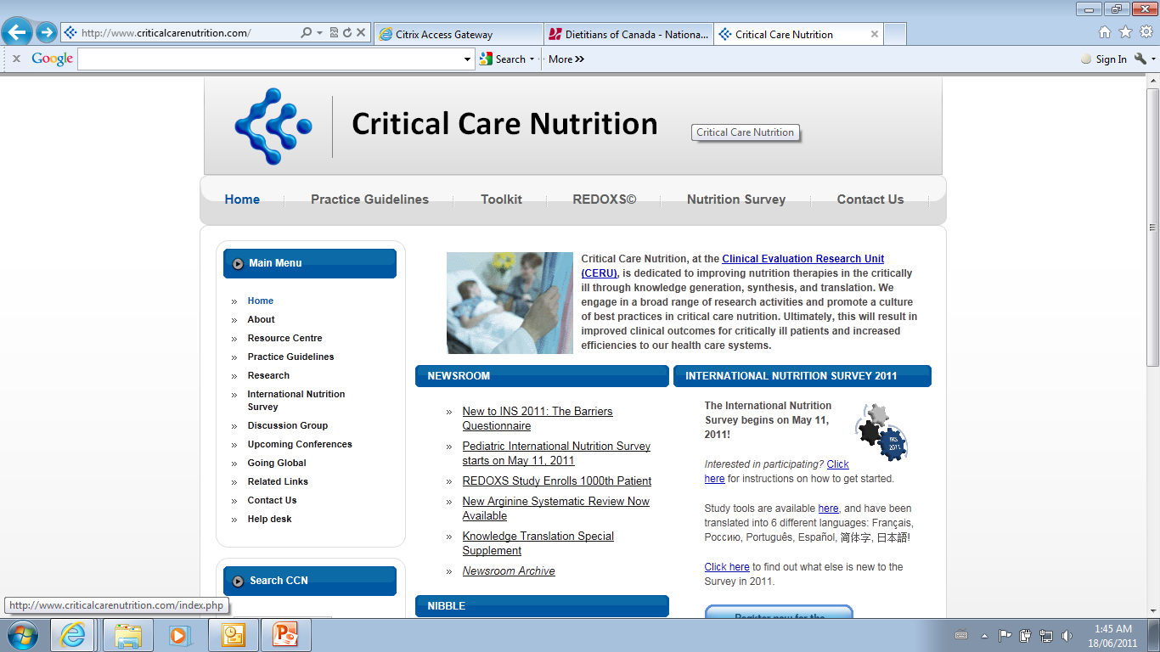
www.criticalcarenutrition.com

Slide 30
Early vs. Delayed EN
www.criticalcarenutrition.com
Based on 11 level 2 studies:
We recommend early enteral nutrition (within 24-48 hours following admission to ICU) in critically ill patients.

Slide 31
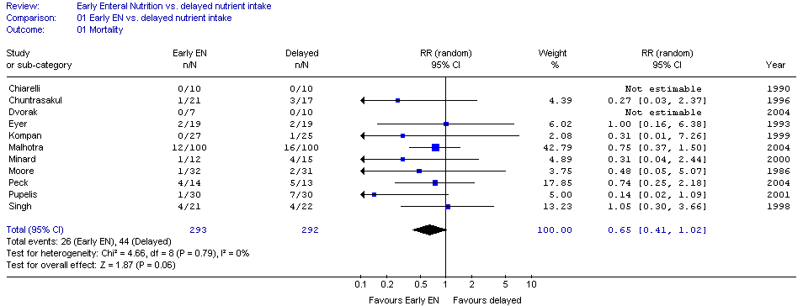
Early vs. Delayed EN

Slide 32
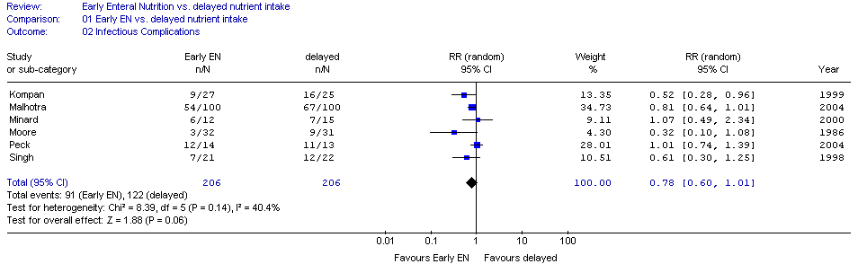
Early vs. Delayed EN

Slide 33
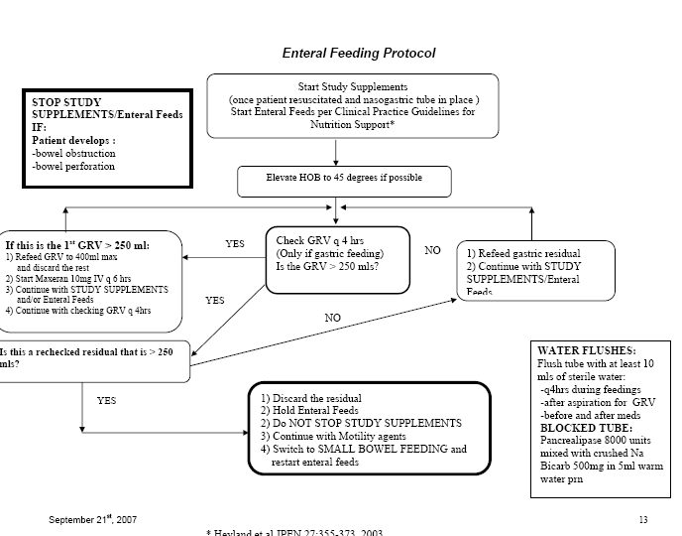
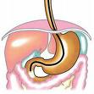


Strategies to Optimize EN
Feeding protocols
Small bowel vs. gastric
Pro-motility drugs
Semi-recumbent position
www.criticalcarenutrition.com

Slide 34
Open abdomen
Byrnes et al, Am J Surg 2010
Retrospective observational n=23
12 EN before fascial closure (7.08 days)
11 EN after fascial closure (3.4 days)
Initiation of EN at 4 days
Similar ISS, mortality and infection

Slide 35
Open Abdomen 2
Collier et al, JPEN 2007
Retrospective observational, n=78
OA >4 days, survived, nutrition data
EEN initiated < 4 days
LEN initiated > 4 days
Male 68%
Blunt trauma 74%
Mean age 35
55% had EEN

Slide 36
Open Abdomen - Results
Collier et al, JPEN 2007
EEN in OA associated with:
Earlier primary closure (74% vs 49%, p=0.02)
Lower fistula rate (9% vs 26%, p=0.05)
Lower hospital charges ($50,000)
Similar demographics, ISS and infections

Slide 37
Arginine supplemented diet
One of the most studied nutrients
Specific effect in surgical stress
  different than in critical illness
Infection in surgery a factor in care
Systematic reviews of arginine supplemented diets on clinical outcomes
  other nutrients included
  combined with the diet

Slide 38
Arginine supplemented diet
Systematic review 1990 - March 2010
RCTs of arginine supplemented diets compared to a standard enteral feed.
Patients having a scheduled procedure
Primary outcome: infectious complications
  Secondary: Hospital LOS, mortality
A priori hypothesis testing
  GI surgery vs Other
  Upper vs Lower GI surgery
  Arg+FO+nucleotides vs Other
  Before vs After or Both
Drover et al, JACS 2010

Slide 39
Arginine results
54 published RCTs identified
35 RCTs included in analysis
  Excluded: duplicates, non-standard, no clinical outcomes and pseudorandomized
Infections (28 studies)
  41% reduction (p<0.0001)
Hospital LOS (29 studies)
  Reduced WMD 2.38days (p<0.0001)
Drover et al, JACS 2010

Slide 40
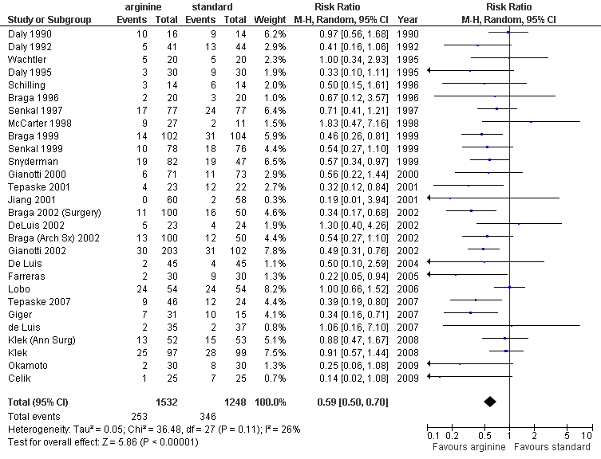
Arginine results

Slide 41
Subgroups
GI surgery vs Other
Upper vs Lower GI vs Both
Arg+FO+nucleotides vs Other
Before vs After vs Both
Drover et al, JACS 2010

Slide 42
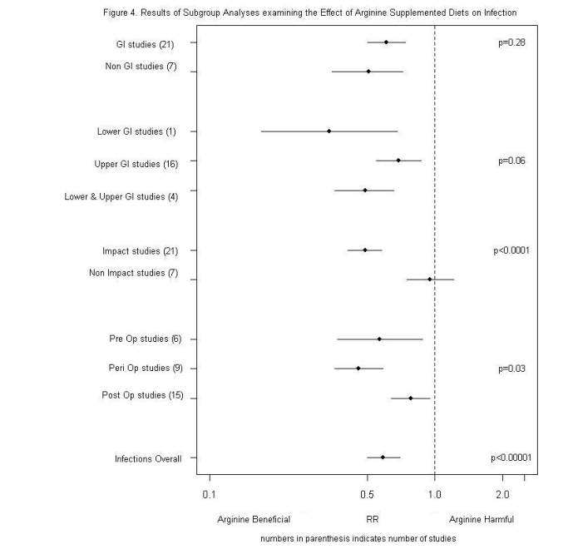
Subgroups

Slide 43
Subgroups

Slide 44
Subgroups
Pre-operative(6 studies)
  43% reduction
Post-operative(9 studies)
  22% reduction
Peri-operative(15 trials)
  54% reduction
Drover et al, JACS 2010

Slide 45
Summary
Arginine supplemented diets associated with reduced infections and HLOS
Effect is across different types of high risk surgery
Greatest effect with:
  Pre and Post operative administration
Drover et al, JACS 2010

Slide 46
Strategies to improve nutrition
First look in the mirror
Implement protocols, care pathways
Establish a relationship
Negotiate a middle ground
Ask for forgiveness in advance
Be persistent
Establish a relationship
Be persistent
Establish a relationship
Be persistent

Slide 47
Case #1
48 yo female with sigmoid cancer
Sigmoid resection
Healthy, uneventful OR
When will this patient be fed?
What will the first diet be?

Slide 48
Case #2
69 year old male, perforated DU
COPD on home oxygen
Post-operatively to ICU
No other organ failure
Predicted slow wean
When do you start enteral nutrition?
How do you start enteral nutrition?
There are no bowel sounds audible – does that affect decision?

Slide 49
Case #3
66yo male with obstructing colon cancer
POD #4 develops sepsis
return to OR, anastamotic leak
  end ileostomy
Unstable in the OR
Post-op unstable transferred to our ICU
  difficult to oxygenate and ventilate - ARDS
  hypotensive on multiple vasopressors
    Vasopressin 0.04u/h
    Noradrenaline 12ug/min
    Dobutamine 5ug/kg/min
When do you start feeds?
What do you do with the Gastric Residual Volumes?

Slide 51
Summary
Surgical patients
Surgeons
Evidence for efficacy of EN
Strategies for change

Slide 52
Thank You

